Slide 1
Army Civil Affairs Support to Resiliency 12-14 DEC 2023 US Army Heritage and Education Center (USAHEC) Carlisle, PA
12/12/2023
Notes:
-Psychological resilience, mental health services (Mongolia)
-what is legal basis for civil defense (UKR)
-what is the price of sovereignty (China’s projection into infrastructure building- BRI)
-economic and energy independence
-competition training opportunities to build knowledge/ insight of partner capability (PHL)
-US narrative globally; DoS recommends focusing locally to draw on cultural uniqueness and primary concern of the population
-IMET, strategic competition
-MDTF- intel sharing with military partners
-build resiliency within a population
-FSI gray zone TTX focused on interagency class short of war
-NATO Stratcom CoE partner lessons learned

Slide 2
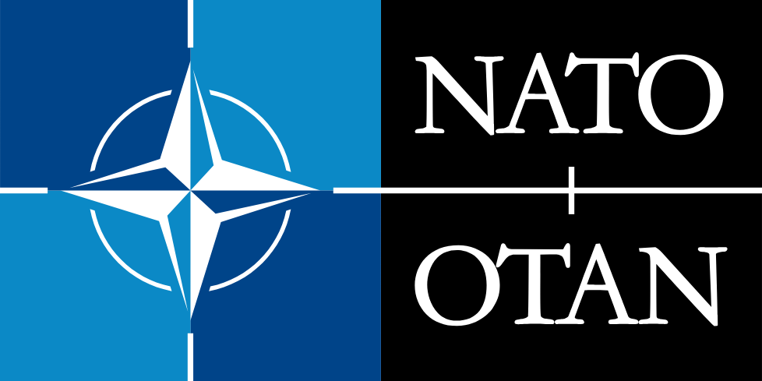
Resiliency Across the Joint and Allied Forces
NSS 2022: Deepen partnerships to advance economic resilience, preserve democratic stability, improve pandemic preparedness, and protect critical infrastructure.
JP 3-0: The joint force achieves resiliency through iterations of experience, training, and education. (includes depth, exchangeability, interoperability, and dispersal)
FM 3-0:
Endurance is about resilience and preserving combat power.
Improve endurance by setting the theater across all warfighting functions.
Improve interoperability with allies and other unified action partners.
FM 3-57:
Support Defense Support to Civil Administration.
Conduct Military Government Operations.
Maintain resilient partners and allies.
Maintain and develop a resilient civil network.
ATP 3-57.40:
Governance Assessment Process to identify gaps in civil resilience.
Identify civil networks with capacity to fill these gaps.
Point of Contact: LTC Brian Meister; (910) 432-7481 email brian.j.meister.mil@socom.mil
Notes:
NSS 2022-
” helping vulnerable nations build resilience to the devastating impacts of the climate crisis through the President’s Emergency Plan for Adaptation and Resilience (PREPARE) and in support of democratic renewal through the Partnerships for Democratic Development (PDD).”
“we are renewing our focus on bolstering our collective resilience against shared
threats from Russia, including asymmetric threats.”
“We are also partnering to help the region build resilience to pandemic disease and to strengthen their health systems, drive investments in global health security, and expand the region’s ability to prevent, detect, and respond to emergencies.”
“As we support Ukraine, we will also work to enhance the stability and resilience of other democracies. We will support the European aspirations of Georgia and Moldova and their commitment to important institutional reforms.”
JP 3-0, Joint Campaigns and Operations “ORGANIZING AND PRACTICING GLOBAL INTEGRATION”
Resilience. Enemy capabilities have increased the need for a resilient joint force. The joint force achieves resiliency through iterations of experience, training, and education. Examples include professional military education and development, force protection measures, depth, exchangeability, interoperability, and dispersal so that a single attack cannot disable it. Depth provides the ability to replace capacity and capability with reserves and the industrial base to produce new assets. Exchangeability is substituting an asset for a lost one. JFCs employ multifunctional units and equipment. These units are modular and scalable, which increases exchangeability and operational flexibility. Dispersal eliminates vulnerability to a single point of failure. These considerations extend to the commercial infrastructure on which the joint force heavily depends, at home and abroad.
JP 3-07, Joint Stabilization Activities,
Planning for Security Sector Reform a. Comprehensive Plan. The military contribution to an SSR program should be incorporated within a comprehensive reform plan, which is a product of all the pertinent stabilization partners. During a FID or COIN operation, the IDAD strategy is the overarching strategy for SSR. In any case, the overarching strategy should set out a realistic timeline for reform that recognizes the context of the issues, as well as the resources available, the HN leadership capacity to deliver change, and existing institutional capabilities.
JP 3-26, Joint Combatting Terrorism
Mission assurance- A process to protect or ensure the continued function and resilience of capabilities and assets, including personnel, equipment, facilities, networks, information and information systems, infrastructure, and supply chains, critical to the execution of Department of Defense mission-essential functions. Also called MA.
FM 3-0, Operations
ENDURANCE (as Army tenant)
Endurance is the ability to persevere over time throughout the depth of an operational environment. Endurance enhances the ability to project combat power and extends operational reach. Endurance is about resilience and preserving combat power while continuing operations for as long as is necessary to achieve the desired outcome. During competition, Army forces improve endurance by setting the theater across all warfighting functions and improving interoperability with allies and other unified action partners.
ATP 3-57.50 Governance Assessment Process: CA forces use the GAP assessment tool to analyze, assess, and evaluate government provision of services, state-resource management, public empowerment, legitimacy, public participation, political accountability. CA forces identify gaps to center the civil network development plan and prioritize deficit areas and systems. They then pass this analysis on to host nation or other government agencies for action or identify civil networks who could fill these gaps.
Strengthening resilience
Resilience in a NATO context refers to the capacity to prepare for, resist, respond to and quickly recover from shocks and disruptions. Strengthening resilience is primarily a national responsibility, but individual Allies’ efforts also make the Alliance stronger as a whole. Allies can enhance their resilience through the development of their national defense capacity, assured access to critical infrastructure and the development of back-up plans in the event of crises. To deter, counter or recover from threats or disruptions in the civilian sector, effective action requires clear plans and response measures that are defined ahead of time and exercised regularly.
seven Baseline Requirements for national resilience against which Allies can measure their level of preparedness:
Seven Baseline Requirements for national resilience level of preparedness:
Assured continuity of government and critical government services: for instance, the ability to make decisions and communicate with citizens in a crisis;
Resilient energy supplies: ensuring a continued supply of energy and having back-up plans to manage disruptions;
Ability to deal effectively with the uncontrolled movement of people and to de-conflict these movements from NATO’s military deployments;
Resilient food and water resources: ensuring resilient supplies that are safe from disruption or sabotage;
Ability to deal with mass casualties and disruptive health crises: ensuring that civilian health systems can cope and that sufficient medical supplies are stocked and secure;
Resilient civil communications systems: ensuring that telecommunications and cyber networks can function even under crisis conditions, with sufficient back-up capacity. This also includes the need for reliable communications systems including 5G, robust options to restore these systems, priority access to national authorities in times of crisis, and the thorough assessments of all risks to communications systems;
Resilient transport systems: ensuring that NATO forces can move across Alliance territory rapidly and that civilian services can rely on transportation networks, even in a crisis.
The Resilience Committee (RC) is the senior NATO advisory body for resilience and civil preparedness. Each NATO member country needs to be resilient against military and non-military threats and challenges to the Alliance’s security, such as natural disasters, disruption of critical infrastructure, or hybrid or armed attacks. Resilience is both a national responsibility and a collective commitment rooted in Article 3 of the North Atlantic Treaty.

Slide 3
FM 3-57: US Army CA Supports Civil Resilience Across the Competition Continuum
Point of Contact: LTC Brian Meister; (910) 432-7481 email brian.j.meister.mil@socom.mil
Notes:
Military government operations support to transitional governance is essential for maintaining stability in periods of competition, promoting resilience during competition, crisis, and assuring continuity of governance during armed conflict.
Transitional governance is the actions taken to assure appropriate control and continuity of government functions throughout the range of military operations. DODD 5100.01 directs the Army to establish a military government when occupying enemy territory, and DODD 2000.13 identifies a military government as a directed requirement under CAO. CA forces evaluates the capability and capacity of the HN to provide essential services for a population. These forces must also determine the ability of other USG agencies, international agencies, NGOs, and contractors to provide support. CA forces, as required, will lead and direct these identified capabilities and capacities until the proper civilian control is enacted. The goal is to address sources of conflict or friction, foster resilience of the HN, and create conditions that enable sustainable peace and security.

Slide 4
ATP 3-57.40: Military Government Operations Support to Transitional Governance
Transitional governance (*Proposed for JP 3-57)
Transition of foreign governing authorities and functions based on a US Government policy decision or directive.
Military government operations (*Proposed for ATP 3-57.40)
The actions taken by Civil Affairs forces to support government functions and governance throughout the competition continuum.
Support to Civil Administration in Host Nation Territory
Support provided to a Host Nation to restore or enhance governance capability.
Support to Civil Administration in Occupied Territory
Support provided to indigenous governing bodies during a military occupation.
Support to Foreign Assistance
Civil or military aid and activities rendered to legitimate indigenous authorities of a foreign nation to support stability and create conditions for long-term stabilization, comprising development assistance, humanitarian assistance, and security assistance.
TRANSITIONAL GOVERNANCE
National Strategic
DIME
(JP 3-57)
Civil Military Ops
Theater Strategic
CCMD/TSOC
(JP 3-57)
Civil Affairs Ops
MILITARY GOVERNMENT
Operational
JTF/MEB/CATF
(FM 3-57/FM 6-27)
Military Government
Ops
TRANSITIONAL MILITARY AUTHORITY
SUPPORT TO FOREIGN ASSISTANCE
SUPPORT TO CIV ADMIN IN HOST NATION TERRITORY
SUPPORT TO CIV ADMIN IN OCCUPIED TERRITORY
Tactical
CA/MP/EN/LG
(ATP 3-57.40)
Point of Contact: Mr. Al Deveyra; (910) 432-1654 email alfonso.j.deveyra.civ@socom.mil

Slide 5
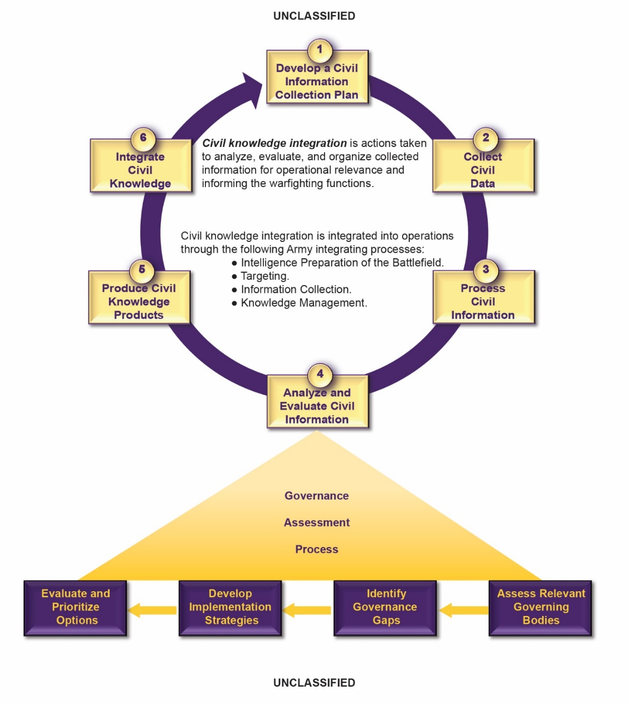
Civil Affairs Governance Assessment Process (GAP)
Point of Contact: Mr. Al Deveyra; (910) 432-1654 email alfonso.j.deveyra.civ@socom.mil
Notes:
CA forces use the GAP assessment tool to analyze, assess, and evaluate government provision of services, state-resource management, public empowerment, legitimacy, public participation, political accountability. CA forces identify gaps to center the civil network development plan and prioritize deficit areas and systems.
The CA Proponent introduces the Governance Assessment Process in the current draft of Army Techniques Publication 3-57.40 Military Government Operations support to Transitional Governance.
The GAP provides the framework for assessing governance by analyzing capability, evaluating the populace’s view of that government’s legitimacy, identifying governance gaps, and modeling strategies for addressing those gaps within the civil component of an area of operations. Forces can use the GAP, which is not tied to an automated platform, at any level. Forces can execute the GAP as a green book, tactical level assessment requiring minimal resources, or as an advanced analytical systems and capabilities. The GAP’s design is effective across the competition continuum, yielding similar results regardless of environment.
Note that when a state at the national or local level does not have the capability, capacity, or motivation to provide for the needs of a target population, then informal governance structures stand up to fill that void. Those informal structures can be in concert with, or antagonistic towards the formal government structure. The GAP aids in the identification of those governance gaps and development of CAO to address them.
The analysis of data and information through the GAP creates the civil knowledge that allows CA planners to develop and evaluate options for affecting legitimacy of relevant governing bodies.
The GAP is explained in appendix A. The four steps below complete the GAP:
Step 1: Analyze relevant governing bodies.
Step 2: Identify governance gaps.
Step 3: Develop implementation strategies.
Step 4: Evaluate and prioritize options.

Slide 6
Terms of Reference
There are no Joint or Army doctrinal term or standardized definition for “resilience”
NATO:
PD-21- Presidential Policy Directive21, Critical Infrastructure Security and Resilience, advances a national policy to strengthen and maintain secure, functioning, and resilient critical infrastructure. The term “sector specific agency” refers to the USG department or agency designated under Presidential Policy Directive-21, Critical Infrastructure Security and Resilience, that provides institutional knowledge and specialized expertise, as well as leading, facilitating, or supporting the security and resilience programs and associated activities of its designated critical infrastructure sector in the all-hazards environment.
JP 3-0, Joint Campaigns and Operations “ORGANIZING AND PRACTICING GLOBAL INTEGRATION”
Resilience. Enemy capabilities have increased the need for a resilient joint force. The joint force achieves resiliency through iterations of experience, training, and education. Examples include professional military education and development, force protection measures, depth, exchangeability, interoperability, and dispersal so that a single attack cannot disable it. Depth provides the ability to replace capacity and capability with reserves and the industrial base to produce new assets. Exchangeability is substituting an asset for a lost one. JFCs employ multifunctional units and equipment. These units are modular and scalable, which increases exchangeability and operational flexibility. Dispersal eliminates vulnerability to a single point of failure. These considerations extend to the commercial infrastructure on which the joint force heavily depends, at home and abroad.
JP 3-07, Joint Stabilization Activities,
Planning for Security Sector Reform a. Comprehensive Plan. The military contribution to an SSR program should be incorporated within a comprehensive reform plan, which is a product of all the pertinent stabilization partners. During a FID or COIN operation, the IDAD strategy is the overarching strategy for SSR. In any case, the overarching strategy should set out a realistic timeline for reform that recognizes the context of the issues, as well as the resources available, the HN leadership capacity to deliver change, and existing institutional capabilities.
JP 3-26, Joint Combatting Terrorism
Mission assurance- A process to protect or ensure the continued function and resilience of capabilities and assets, including personnel, equipment, facilities, networks, information and information systems, infrastructure, and supply chains, critical to the execution of Department of Defense mission-essential functions. Also called MA.
Strengthening resilience
Resilience in a NATO context refers to the capacity to prepare for, resist, respond to and quickly recover from shocks and disruptions. Strengthening resilience is primarily a national responsibility, but individual Allies’ efforts also make the Alliance stronger as a whole. Allies can enhance their resilience through the development of their national defense capacity, assured access to critical infrastructure and the development of back-up plans in the event of crises. To deter, counter or recover from threats or disruptions in the civilian sector, effective action requires clear plans and response measures that are defined ahead of time and exercised regularly.
seven Baseline Requirements for national resilience against which Allies can measure their level of preparedness:
Seven Baseline Requirements for national resilience level of preparedness:
Assured continuity of government and critical government services: for instance, the ability to make decisions and communicate with citizens in a crisis;
Resilient energy supplies: ensuring a continued supply of energy and having back-up plans to manage disruptions;
Ability to deal effectively with the uncontrolled movement of people and to de-conflict these movements from NATO’s military deployments;
Resilient food and water resources: ensuring resilient supplies that are safe from disruption or sabotage;
Ability to deal with mass casualties and disruptive health crises: ensuring that civilian health systems can cope and that sufficient medical supplies are stocked and secure;
Resilient civil communications systems: ensuring that telecommunications and cyber networks can function even under crisis conditions, with sufficient back-up capacity. This also includes the need for reliable communications systems including 5G, robust options to restore these systems, priority access to national authorities in times of crisis, and the thorough assessments of all risks to communications systems;
Resilient transport systems: ensuring that NATO forces can move across Alliance territory rapidly and that civilian services can rely on transportation networks, even in a crisis.
The Resilience Committee (RC) is the senior NATO advisory body for resilience and civil preparedness. Each NATO member country needs to be resilient against military and non-military threats and challenges to the Alliance’s security, such as natural disasters, disruption of critical infrastructure, or hybrid or armed attacks. Resilience is both a national responsibility and a collective commitment rooted in Article 3 of the North Atlantic Treaty.
Army:
FM 3-0, Operations
ENDURANCE (as Army tenant)
Endurance is the ability to persevere over time throughout the depth of an operational environment. Endurance enhances the ability to project combat power and extends operational reach. Endurance is about resilience and preserving combat power while continuing operations for as long as is necessary to achieve the desired outcome. During competition, Army forces improve endurance by setting the theater across all warfighting functions and improving interoperability with allies and other unified action partners.
FM 3-57, Civil Affairs Operation
Military government operations support to transitional governance- essential for maintaining stability in periods of competition, promoting resilience during competition, crisis, and assuring continuity of governance during armed conflict. Transitional governance is the actions taken to assure appropriate control and continuity of government functions throughout the range of military operations. DODD 5100.01 directs the Army to establish a military government when occupying enemy territory, and DODD 2000.13 identifies a military government as a directed requirement under CAO. CA forces evaluates the capability and capacity of the HN to provide essential services for a population. These forces must also determine the ability of other USG agencies, international agencies, NGOs, and contractors to provide support. CA forces, as required, will lead and direct these identified capabilities and capacities until the proper civilian control is enacted. The goal is to address sources of conflict or friction, foster resilience of the HN, and create conditions that enable sustainable peace and security.
Army Civil Affairs Doctrine:
ATP 3-57.40 (Initial draft)
Civil Affairs forces support the DOD effort to prevent the escalation of crisis into conflict. Regional, persistent engagement before, during, and after a crisis enables CA forces to identify and work with civil networks that provide early warning to impending crisis. These same networks provide on the ground capability to build resilience against crisis as well as having the elements in place to respond to the needs of the populace during and after crisis. Civil networks and U.S. forces must identify a crisis quickly to divert or respond to it to ensure the crisis does not transition into conflict or transition back to competition at a position of relative advantage.
Point of Contact: LTC Brian Meister; (910) 432-7481 email brian.j.meister.mil@socom.mil

Slide 7
Civil Affairs Resiliency Gap Analysis
PKSOI Breakout session Questions:
What are your Regional sources of Instability?
Ineffective/ inefficient form of governance
How do your Stability OAI’s (Operations, Activities, and Investments) contribute to Resiliency? Effectiveness?
Execute deliberate assessment of partner resilience capability (Governance Assessment Process; NATO Combat Readiness Evaluation and NATO Operational Capability Concept (OCC) Evaluation and Feedback (E&F) program
Where are the opportunities to mitigate risk and implement resiliency minded efforts?
Promote an active mental health program for military and dependents
Develop and employ a military government capability across the competition continuum (38G)
Develop a capability to resource governance/ government experts through a CBOS (TRADOC G2 Global Cultural Knowledge Network, academia, etc)
Secretary of Defense Civilian Harm Mitigation and Risk- Action Plan (focus on proactive measures to mitigate harm vs BDA only)
What are the DOTMLPF-P Stability gaps preventing capitalization on these opportunities?
No standardized TOR for resilience across services
Civil knowledge lacks a federalized platform (material) across Joint and major services standardization
Provide actionable prioritized recommendations to close those gaps?
38 G (Military Government)
CA forces conduct CAO in support of the elements of decisive action to—
Point of Contact: LTC Brian Meister; (910) 432-7481 email brian.j.meister.mil@socom.mil

