Slide 1
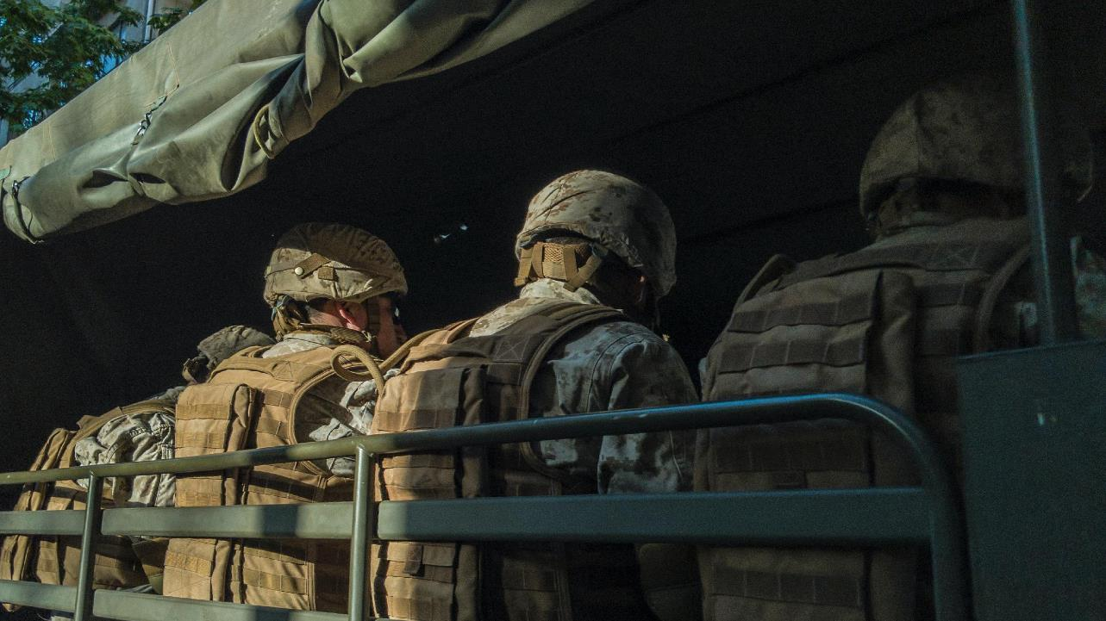
Resiliency Summit: Carlisle, PA
“A Guide for Measuring State Resiliency”
Joint Special Operations University
Robert S. Burrell, PhD
13 Dec 2023

Slide 2
A GUIDE TO MEASURING STATE RESILIENCY
Problem Statement
Apply a more advanced human-centric model in assessing current levels of governmental and societal resilience to subversion and coercion, and internal and/or external aggression.

Slide 3
A GUIDE TO MEASURING STATE RESILIENCY
Resiliency and Resistance Model
Population
1
1
Resistance
2
2
Resilience
3
4
4
5
5
External Support
Gaining support of the population
Disrupt opponent's control over the population
Direct action against opponent
Disrupt opponent's relations with the international community
Establish relationships with the international community

Slide 4
A GUIDE TO MEASURING STATE RESILIENCY
Resiliency Measurement
ASSESSMENT: | DATA FIELDS | SOURCES
Resiliency Measurement: Describe the country and population in terms of physical aspects, state fragility, cultural resilience, and governance. Remember that the human terrain is the focus of study but that physical aspects may shape will and perceptions. | Physical | https://www.cia.gov/the-world-factbook/
 |  | population size, ethnic groups, languages, religions, government type, GDP per capita. All this context is important to consider but not necessarily a measurable statistic.
 | State Fragility | https://fragilestatesindex.org/
 |  | ranking of the country's fragility in comparison to others.
 | Cultural Resilience | https://www.swissre.com/dam/jcr:3f36e9da-fe0f-401d-8648-9a12770ffc0f/2022-june-sigma-resilience-index-en.pdf
 |  | this index ranks 31 countries in order of their ability to absorb a range of “shocks”, including natural disasters and financial collapse. It measures nations against nine benchmarks.
 | National Morale | https://muse.jhu.edu/pub/419/article/851424/pdf
 |  | this article offers models to analyze a nation's will to fight. Table one offers methods to access a military's will to fight, while Table 2 examines national will factors.
 | Governance | https://info.worldbank.org/governance/wgi/
 |  | ranking of the country's governance in comparison to others, using accountability, stability, effectiveness, regulations, rule of law, and corruption

Slide 5
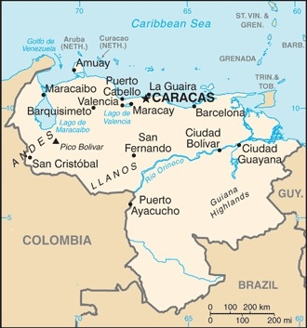
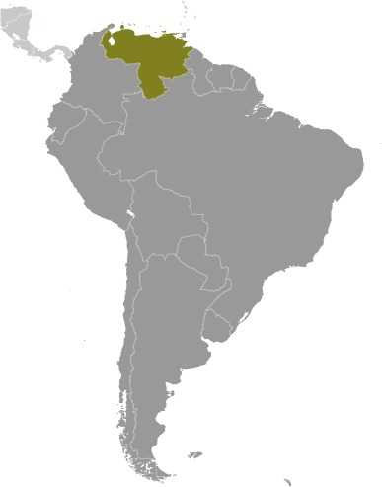
A GUIDE TO MEASURING STATE RESILIENCY
Case Study of Venezuela

Slide 6
A GUIDE TO MEASURING STATE RESILIENCY
Venezuela Example: Radar Chart
State Fragility
National Will
Social
Resilience
Government Accountability
Political
Stability
Government Effectiveness
Regulation Efficiency
Rule of Law
Control of Corruption
16.2%
33.3%
33.3%
6.8%
12.3%
5.2%
2.4%
.5%
1.9%

Slide 7
A GUIDE TO MEASURING STATE RESILIENCY
Left off the table in this paper…
PHASE | STEPS
One | 1. Measuring the state’s resiliency. (the only step discussed here)
 | 2. Identifying the potential for a state-sponsored resistance strategy.
 | 3. Measuring the potential for external support to resiliency.
 | 4. Measuring the potential for resistance to current authority.
 | 5. Measuring the potential for external support to resistance.
Two | 6. Identifying the prevalent resistance groups within the state and placing them on the Resistance Continuum.
Three | 7. Assessing one or more resistance groups in terms of leadership,
 | 8. cause,
 | 9. environment,
 | 10. organization,
 | 11. and actions.
Four | 12. Making a recommendation concerning potential external support to resiliency or resistance, which normally proposes one of three options: (a) support resilience, (b) support resistance, or (c) do nothing.

Slide 8
A GUIDE TO MEASURING STATE RESILIENCY
Questions
Robert S. Burrell and John Collision. “A Guide to Measuring Resiliency and Resistance.” Resiliency and Resistance: Interdisciplinary Lessons in Irregular Warfare, Competition, and Deterrence. Joint Special Operations University Press, 2024.

