Slide 1


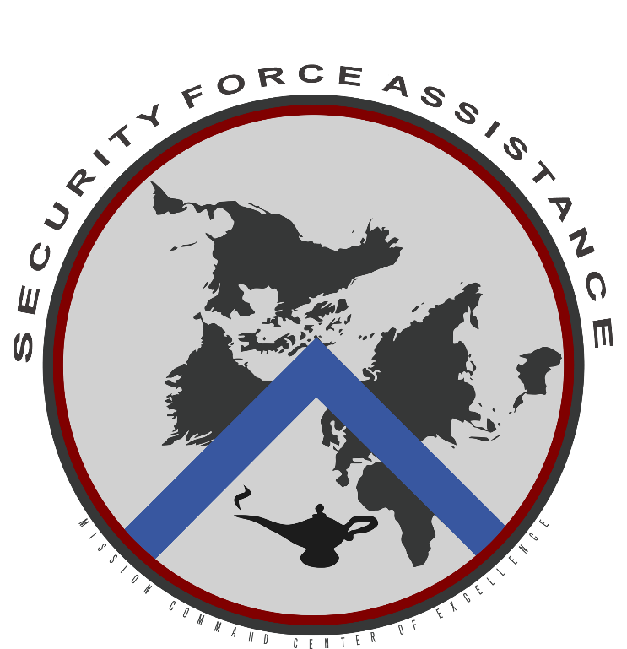
FM 3-22 Army Support to Security Cooperation
13 DEC 2023
US Army Heritage and Education Center (USAHEC)
Carlisle, PA
11/8/2023

Slide 2
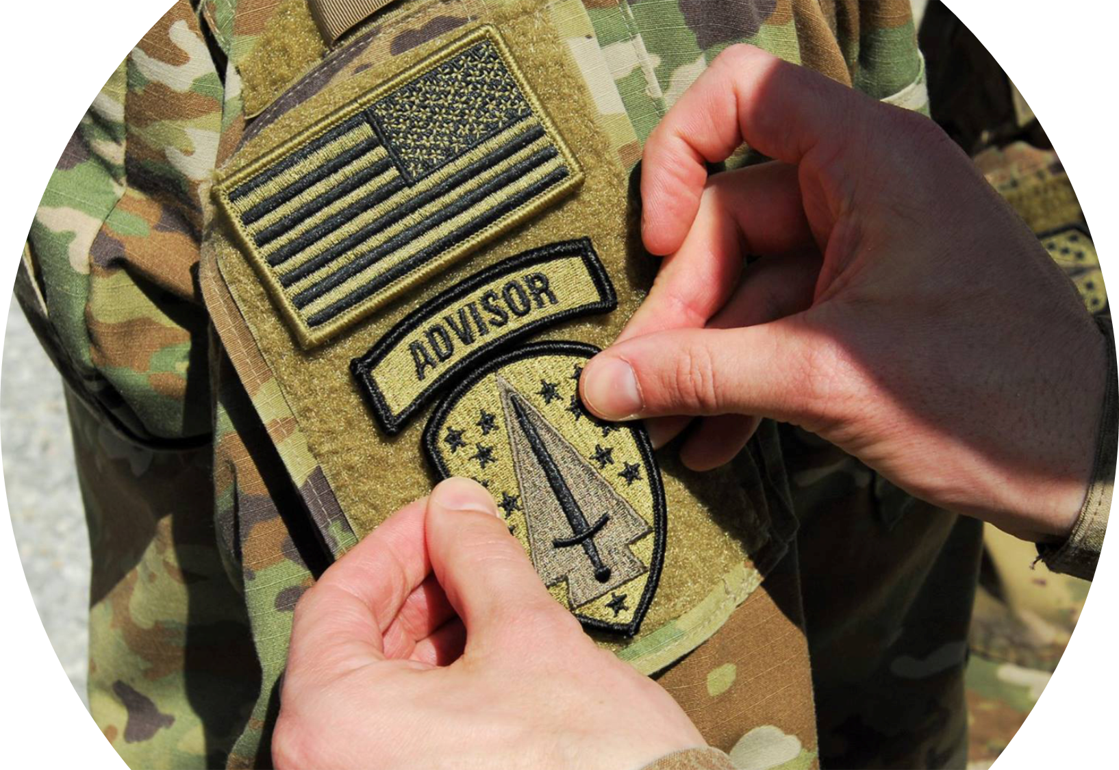
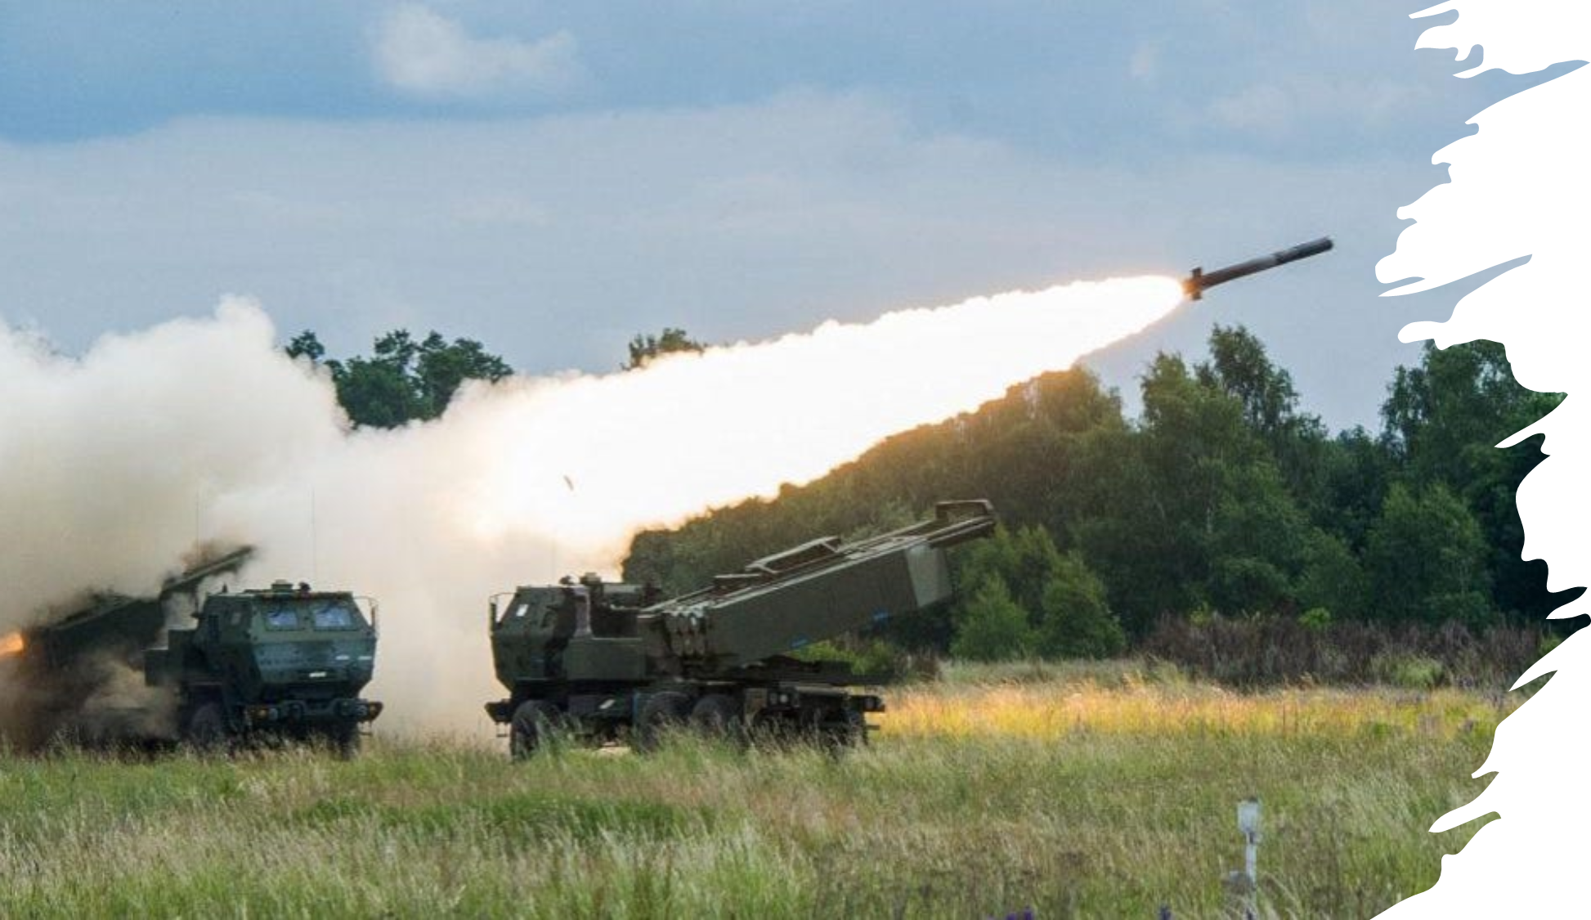
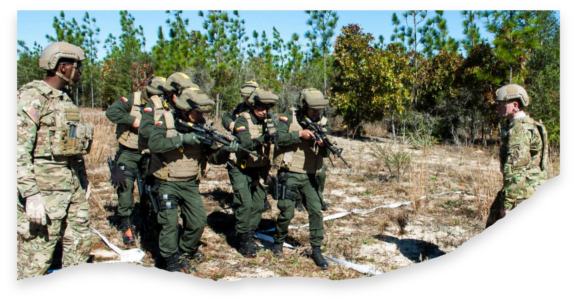
Purpose
Provide an overview of FM 3-22 Army Support to Security Cooperation (2023)
FM 3-22
ARMY SUPPORT TO
SECURITY COOPERATION
Agenda
The Evolution of Security Cooperation Doctrine
Ch 1: Strategic Context
Ch 2: Security Force Assistance (SFA)
Ch 3: Security Cooperation (SC) in the Competition Continuum
Ch 4: Legal Considerations
June 2023
DISTRIBUTION RESTRICTION
Approved for public release; distribution is unlimited.
This publication supersedes FM 3-22, dated 22 January 2013.
HEADQUARTERS, DEPARTMENT OF THE ARMY
FM 3-22
ARMY SUPPORT TO SECURITY COOPERATION

Slide 3
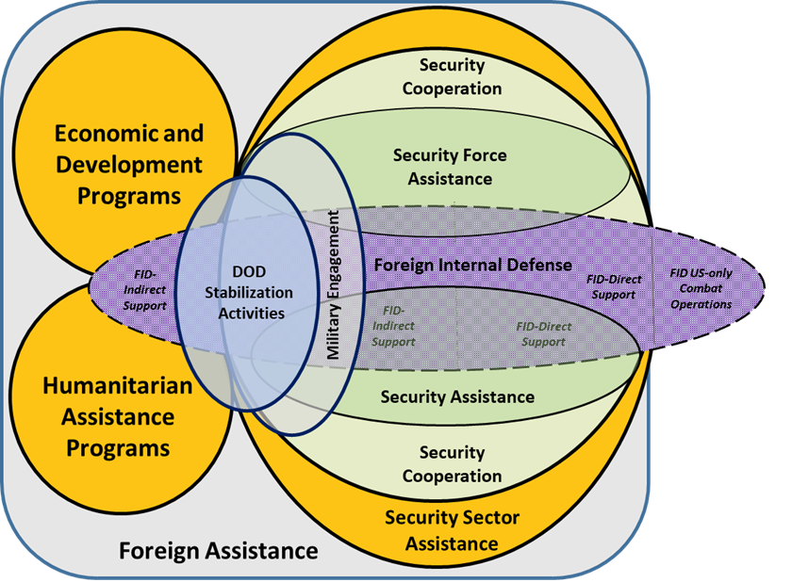
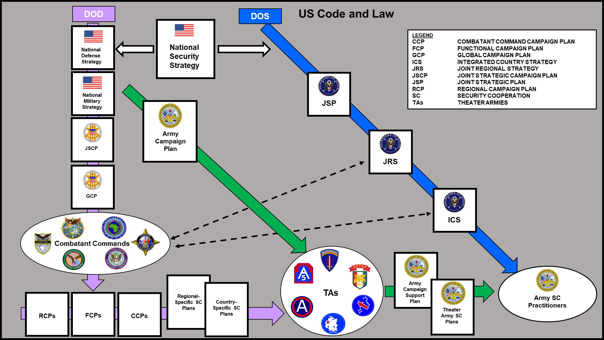
Strategic Context
The purpose of SC is to enable the Joint Force to leverage the capabilities of our partners and allies
Security Cooperation is the enabling function that integrates Allies and Partners into Multi-Domain Operations
DOD Security Cooperation is nested within DOS Foreign Assistance (Security Sector Assistance)
SC is comprised of three different activities: security assistance (SA), security force assistance (SFA), and military engagement.
Army SC practicioners nest with National strategic guidance passed through both DOD and DOS strategic documents
DOS guidance and the Integrated Country Strategy take precedence
*TAB A: Page 1-3, Figure 1-1. Interrelationship of foreign assistance and security cooperation activities
*TAB B: Page 1-10, Figure 1-2. Strategic guidance to
Army campaign support planning
Point of Contact: CPT Francine Lane
Notes:
The fundamental purpose of Security Cooperation is to harness the strengths and capabilities of our partners and allies. This cooperative approach is critical as it serves as a force multiplier within Multi-Domain Operations, allowing us to operate more effectively by integrating diverse capabilities.
It's important to recognize that the Department of Defense's SC efforts are part of a larger framework, operating under the guidance of the Department of State's Foreign Assistance programs, specifically within the realm of Security Sector Assistance. This ensures that our military efforts are aligned with the diplomatic and national security objectives of the United States.
SC itself is not a single activity; it is an umbrella term that encompasses three distinct yet interrelated activities:
Security Assistance (SA), which involves providing equipment, training, or other support to partner nations.
Security Force Assistance (SFA), focused on developing the capabilities of partner nation security forces.
Military Engagement, which includes various military-to-military interactions aimed at strengthening alliances and partnerships.
For Army SC practitioners, it is vital to nest our efforts within the broader context of national strategy. This means that our actions are not only guided by the Department of Defense but also by the strategic documents and directives of the Department of State. The DOS provides guidance through its Integrated Country Strategy, which outlines objectives for U.S. engagement with specific countries, and this takes precedence in guiding our SC efforts.
In essence, effective SC ensures that we are not acting in isolation but are part of a coordinated approach to national security, leveraging global partnerships in a strategic and integrated manner.
The Army’s support to SC builds defense relationships that promote US interests, develop Allies/friendly military capabilities for self defense and multi-national operations, and provide US forces with peacetime & contingency access to Host nations to prevent & deter conflict

Slide 4
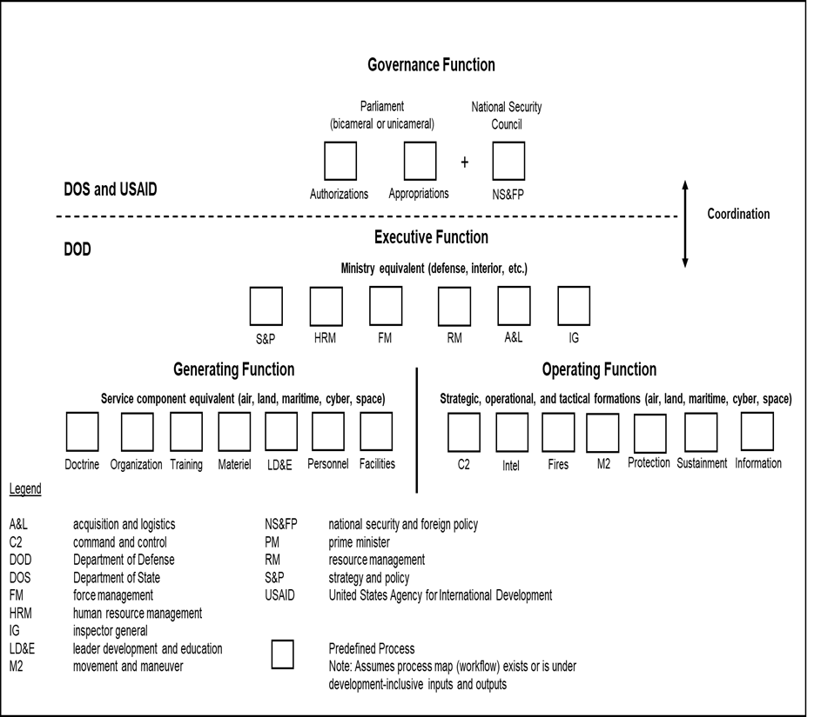
Security Force Assistance
Security Force Assistance is defined as DOD activities that support the development of the capability and capacity and enable the interoperability of foreign security forces and their supporting institutions.
Security Force Assistance is the activity which enables Allies and Partners to integrate into Multi-Domain Operations
  Develop Allies and partners during competition
  Embedded team to support and advise during crisis/conflict
G-EGO
New methodology for describing security establishment functions (JP 3-20)
  Governance: Department of State focus
  Executive function: Joint and Army focus
  Generating function: Critical for Institutional Capacity Building
  Operating function: Can be fleeting gains if not supported by above
KEY NEW IDEA:
  Simultaneous engagement across EGO is most effective.
  Must nest with DOS Governance efforts
Point of Contact: CPT Francine Lane
Notes:
SFA and other SC activities represent an important investment and commitment by the United States into the security apparatus of the PN. The willingness of the United States to commit resources encourages partner willingness to provide access in support of U.S. strategic requirements.
A continuous U.S. presence (such as, cooperative security locations, forward operating stations, main operating bases) is fundamental to the capability and capacity development of the partner FSF, and critical to building and maintaining trust and rapport with the host nation. SFA activities provide the “ways” to accomplish this end state by nurturing current alliances and building new partnerships designed to build partner capability and capacity through continuous engagement.
This persistent engagement is crucial for several reasons:
Developing Partner Capacity: Through SFA activities, we're not just training and equipping forces; we're building institutional resilience and advancing operational competencies.
Building Alliances and Partnerships: Our activities are designed to cultivate long-term relationships that are mutually beneficial. It's about enhancing the ability of our partners to operate alongside us, ensuring that our strategic interests are aligned and that we can rely on each other when needed.
Strategic Access: The resources we commit often encourage partner nations to reciprocate, granting us access and influence that are vital for our own strategic needs and interests.
Trust and Rapport: A continuous presence helps us foster enduring relationships, which are the cornerstone of any alliance. Trust is essential, not only at the diplomatic level but also on the ground where our forces interact.

Slide 5
SC in the Competition Continuum
SC in Competition Below Armed Conflict
Key New Ideas for Security Cooperation during Competition:
  Start from contingency plans for conflict and plan backwards
    What capabilities do partners needs to best contribute to a contingency plan? Develop SA efforts and SFA missions to build those capabilities
    What interoperability gaps exist for the contingency plan? Develop SA efforts and SFA missions to focus on those gaps
    Where might we need embedded support teams during conflict? Pair up SFA units with those partner forces in competition and build relationships early
    Where might we need access agreements for use of an SPOD, APOD, piece of airspace, infrastructure, electromagnetic spectrum? Where might an ACSA extend the operational reach of US logistics? Conduct SFA events and/or exercises that necessitate the creation of the necessary access agreements in competition.
Point of Contact: CPT Francine Lane
Notes:
During competition below armed conflict, Security Cooperation Efforts (both SA and SFA) enables relationships that support the continuous
operational preparation of the environment. The influence gained by the presence of SFA forces—
• Supports the partner FSF in setting the theater for multidomain and multinational operations by creating access agreements.
• Provides and develops added partner FSF layers of intelligence, surveillance, and reconnaissance capability to the network.
• Enables the partner FSF to gain and provide improved situational awareness and understanding of the operational environment, and
enables them to share that information with the combatant command and regionally aligned units
• Supports and enables the partner FSF to preserve the consolidation and protection of critical capabilities, assets, and activities in theater.

Slide 6
SC in the Competition Continuum
Security Cooperation in Crisis
In crisis, Security Cooperation enables the Joint and Multinational Force to rapidly present credible integrated deterrence options that demonstrate the ability to impose costs on malign action.
Key new ideas:
  SFA forces deployed during Competition will become an “Inside force” when a Crisis develops
    Already present “inside” adversary A2/AD bubble
    Anticipate potential crisis locations and arrange for persistent advisory missions in likely crisis areas
    SFA forces on these missions need to be prepared to rapidly transition to conflict
  In addition to “inside forces” already present when crisis develops,
    Small SFA forces can rapidly deploy into Crisis areas and embed with partner ground forces
    Rapidly builds credible combat power by creating an MDO capable ground force that can integrate US Joint Enablers
Point of Contact: CPT Francine Lane
Notes:
In crisis, Security Cooperation enables the joint and multinational force to present credible and integrated deterrent options that demonstrate the
ability to impose costs on malign action
SFA elements enable an agile response by the joint force in the rapid transition to combat operations. SFA forces co-located or embedded with the
partner FSF can—
• Support and enable integration and synchronization of U.S. and partner activities
• Provide insight on key capability gaps within the partner FSF structure
• Provide “on-the-ground” situational awareness to theater planners
• Help to ensure unity of purpose and mutual support in offensive operations
• Enable the joint force to maintain freedom of action and positions of relative advantage

Slide 7
SC in the Competition Continuum
SC in Armed Conflict:
Leveraging multinational forces to create overmatch
Key new ideas:
Security Assistance in Conflict:
Multiple Title 22 authorities permit the rapid movement of US materials to aid partner forces in Conflict
Must anticipate that some Allies will do the same
Synchronizing and integrating this material = significant effort
Must be fully synchronized with Security Force Assistance effort to train and equip
Security Force Assistance in Conflict:
Historical Example: 5th Special Forces Group embedded with Arab Corps in Desert Storm:
  Integrated Arab Corps into Air Land Battle
  Now, SFA forces integrate partners and allies into Multi-Domain Operations
Train and equip: Must be fully synchronized with Security Assistance effort
Point of Contact: CPT Francine Lane
Notes:
Expanding the Battlespace in Conflict
SFA provides commanders with more options to exploit both strategic and operational indirect approaches in a globally integrated operation against a peer adversary. SFA can leverage partner FSF capabilities and their inherently forward posture to expand the battlespace by maneuvering in areas inside and outside the traditional theater geometry. Properly advised, equipped, and trained partner FSF forces can operate inside the adversary’s A2/AD zones to provide credible and survivable capabilities that undermine area denial stratagems. Likewise, properly advised, equipped, and trained partner FSF outside forces may be surged to enable the Army and joint force to control terrain, consolidate gains, and secure strategic support areas.
The future LSCO battlefield will be a noncontiguous battlespace where commanders must be able to integrate long-range precision fires and create effects across multiple domains. SFA forces embedded with foreign security forces must be capable of operating in an austere environment without immediate access to U.S. Army support. These forces must have robust communications capabilities to synchronize U.S. enablers with FSF maneuver. Tactical mobility may be necessary and a potential lack of access to U.S. support may necessitate the use of host nation transportation assets. Embedded SFA advisors must also be trained and equipped to operate outside the range of immediate U.S. medical support. This may require advanced medical training and/or a reliance on FSF medical facilities.
Leveraging Multinational Forces to Create Overmatch
Expanding the battlespace and striking across domains in depth through speed, range, and the convergence of multidomain capabilities provides multinational commanders with the ability to gain and maintain decision dominance and the overmatch necessary to prevail in LSCO. SFA teams embedded with the partner FSF can help set the conditions for overmatch by executing and enabling nonlinear operations. Given expansive geometry of globally contested operations and a numerically superior adversary, multinational forces create overmatch through their ability to attack throughout the depth of the battlespace and to survive adversary counterstrikes. The partner FSF, properly enabled by SFA, can be instrumental in turning complex terrain into an advantage, enabling the multinational forces to attack and defeat land, air, and maritime targets by integrating multinational sensors and platforms.

Slide 8
Legal Considerations
Legal Authority for SC
Foreign Assistance Act, the Arms Export Control Act, and various sections of Titles 10 and 22, USC.
    Congressional Requirements for SC
    Leahy Amendments
    Women, Peace and Security (WPS) requirements
    End-Use Monitoring
Key SC Funding Programs and Authorities under Title 22
Sections 2761/2, 2769, Foreign Military Sales (FMS)
Section 2763, Foreign Military Financing (FMF)
Section, 2347, International Military Education and Training (IMET)
Sections 2321j, 2761, Excess Defense Articles (EDA)
Section 2318, Presidential Drawdown Authority (PDA)
Key SC Funding Programs and Authorities (Title 10)
311, Exchange of Defense Personnel
321, Training with Friendly Foreign Countries
322, 331, Support for Conduct of Operations.
332, Defense Institution Capacity Building.
333, Build Capacity.
341, State Partnership Program (SPP).
Point of Contact: CPT Francine Lane
Notes:
The Leahy Amendments, Women, Peace, and Security requirements, and stringent End-Use Monitoring underscore our commitment to responsible and ethical engagement, ensuring that our efforts are not only strategic but also principled.
Through Title 22, programs like Foreign Military Sales and Financing, International Military Education and Training, and Excess Defense Articles, we empower our partners, enhancing our collective security landscape.
Under Title 10, we further our reach through personnel exchanges, capacity building, and the State Partnership Program, promoting a global network of resilient and interoperable forces.
Finally, the Department of State's leading role in foreign assistance ensures a unified, civilian-led approach, with the Department of Defense providing essential support, in alignment with U.S. foreign policy objectives.
In conclusion, Security Cooperation is a critical tool in advancing U.S. interests, fostering global stability, and building enduring partnerships. The legal and financial frameworks we operate within are not just guidelines but are reflective of our nation’s strategic vision. They enable us to project strength, support allies, and prepare for a spectrum of contingencies—from competition below armed conflict to full-scale operations.

