Slide 1
Irregular Warfare Proponent Brief
For the
PKSOI Resiliency Summit
Status Update
11 December 2023
Agenda:
IW Origins
Institutional Modernization
IW Activities and Operations
The IW Academy
IW Academy
Type Brief: Information
OPR: SWCS IW Proponent
Director: LTC Murphy
Deputy/AO: Mr. Georgevitch
gregory.georgevitch@socom.mil
Office: 432-9400

Slide 2

Irregular Warfare Origins
Absent conventional or nuclear war, we find ourselves confronted with, “…another type of warfare, new in its intensity, ancient in its origins, war by guerillas, subversives, insurgents, assassins, war by ambush instead of aggression...a form of warfare uniquely adapted…these are the kinks of challenges that will be before us in the next decade if freedom is to be saved a whole new kind of strategy, a wholly different kind of force, and there a new and wholly different kind of military training…your education must prepare you for the non-military problems you will face.”
(President John F. Kennedy’s remarks at the 1962 graduation exercises at the United States Military Academy in West Point NY)
The Army’s Irregular Warfare Proponent/Academy located at the United States Army John F. Kennedy Special Warfare Center and School (USAJFKSWCS) must define, teach, and then institutionalize how unique IW operations and activities complement and enable conventional forces and whole-of-government overseas activities.

Slide 3
Institutional Modernization
The Army’s large-scale combat operations model perceives an exceptionally linear, contiguous,
and physically defined geographic space for separating the conflict area immediately forward
of the line of attack.
Although descriptive to maneuver forces, the Army multidomain operations concept does not address the potential operations and activities occurring beyond the strategic flanks and periphery of the predominantly kinetic fight – whereas Irregular Warfare activities and operations offer options.
To balance the focus on large-scale combat operations, ARSOF must institutionalize how to integrate unique Irregular Warfare operations and activities in the Army and the joint force.

Slide 4
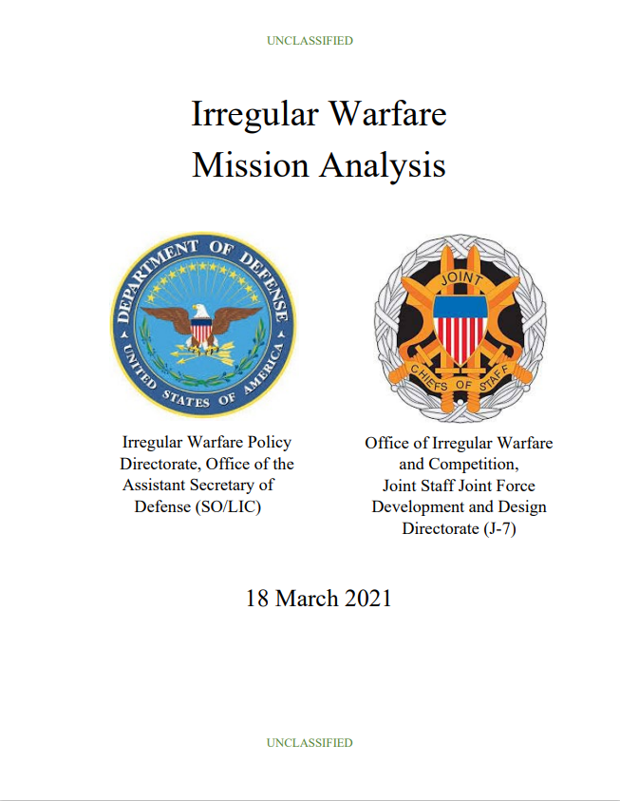
Why IW is Critical to WoG, vital to Campaigning
Irregular Warfare Mission Analysis:
Adapting our approach and institutionalization of IW is critical to the Department’s success in supporting a whole-of-government approach to competition.
Irregular warfare is as strategically important as traditional warfare. It is a vital component of our defense strategy,
military campaigning, and warfighting.
Our strategic culture must adapt to embrace the mindset necessary to succeed in persistent, long-term irregular warfare missions and compete more effectively against all adversaries in all the physical domains and the information environment

Slide 5
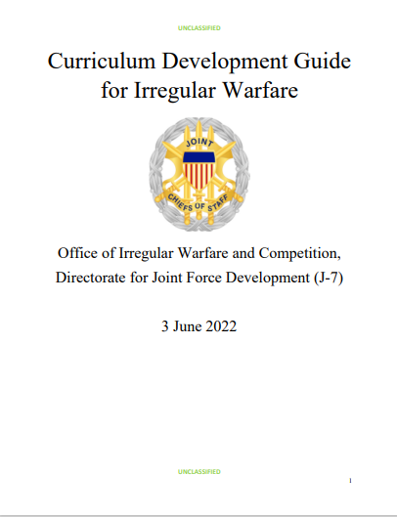
Why IW Matters to Doctrine, Training, Leadership and Education
Curriculum Development Guide for Irregular Warfare:
Highlights IW requirements and provides context and resources for instructors to incorporate IW learning into programs and courses.
IW is as strategically important as traditional warfare and DoD must be equally capable in both.
Apply IW capabilities and concepts to incorporate IW-related matters into institutional processes for strategic planning, resource allocation, force management, and force development and design.
Infuse IW throughout PME, as irregular warfare must not be sequestered to electives.

Slide 6
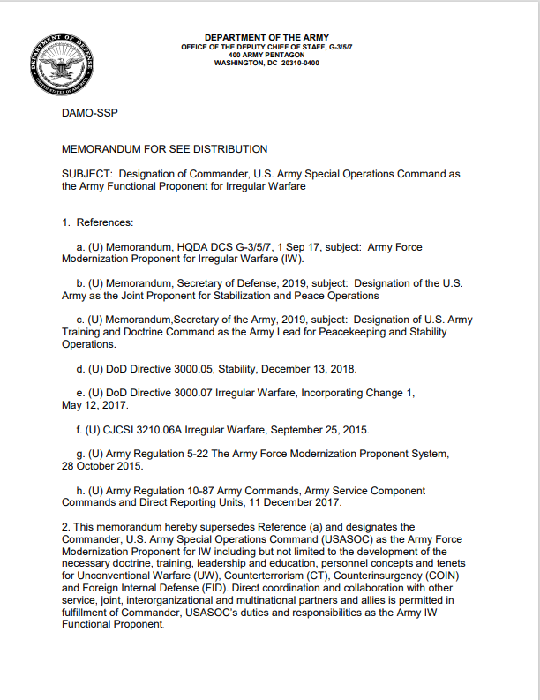
Designation - Army Functional Proponent for IW
U.S. Army Special Operations Command (USASOC) as the Army Force Modernization Proponent for IW including but not limited to the development of the necessary doctrine, training, leadership and education, personnel concepts and tenets for Unconventional Warfare (UW), Counterterrorism (CT), Counterinsurgency (COIN) and Foreign Internal Defense (FID).
U.S. Army Training and Doctrine Command as the Army Lead for Peacekeeping and Stability Operations, and Security Force Assistance (SFA). The Mission Command Center of Excellence, U.S. Army Combined Arms Center (CAC) will serve as the Army Proponent and Service lead for Army Stabilization and SFA doctrine, organization, training, exercises, leadership and education.

Slide 7
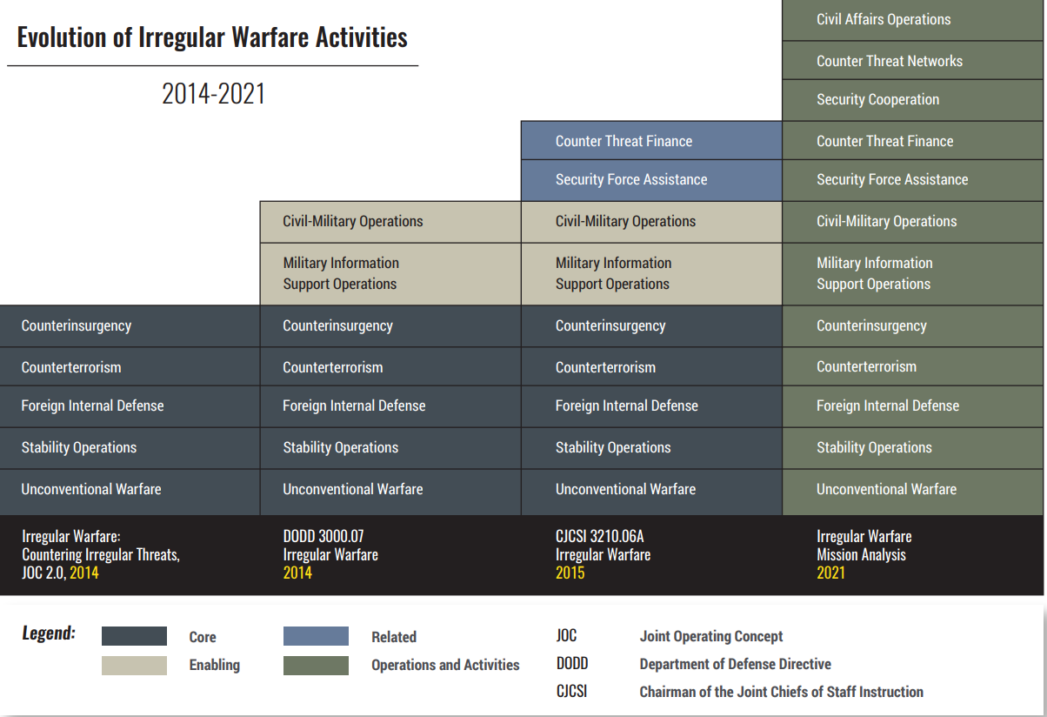
IW Activities and Operations

Slide 8
The Irregular Warfare Academy
Akin to the U.S. Army’s Maneuver Center of Excellence effort to establish a Large-Scale Combat Operations Academy to address traditional warfare; the Army’s Irregular Warfare Functional Proponent at USAJFKSWCS as the Special Operations Center of Excellence (SOCoE) will establish an academy to address Irregular Warfare.
As part of the USAJFKSWCS 2030 strategic vision, the Irregular Warfare Academy – in this first year – is focused on refining its vision, publishing the first keystone doctrine, and institutionalizing IW training and Education within Army Special Operations Forces (ARSOF) curricula. Once the key ARSOF milestones are met, we will then focus our efforts into inculcating IW into PME across the Army and eventually provide education opportunities to the Joint Force.
The Irregular Warfare Academy – Envisions three supporting functional lines of effort to institutionalize Irregular Warfare operations and activities.

Slide 9
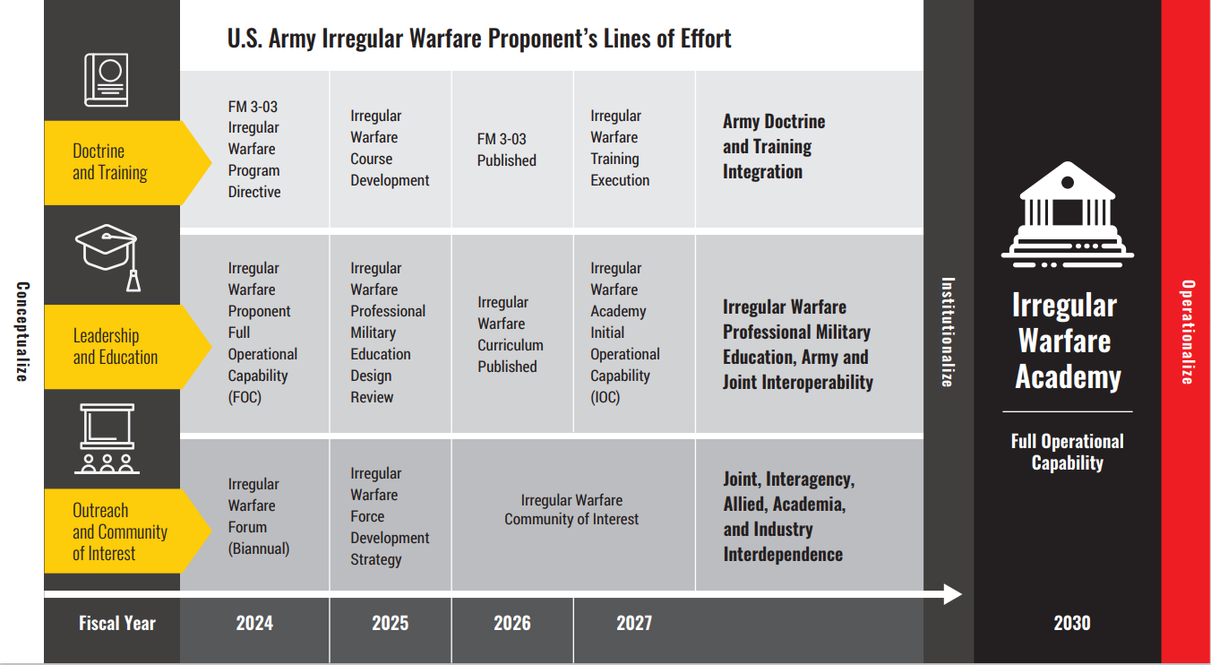
Irregular Warfare Academy Focus

Slide 10
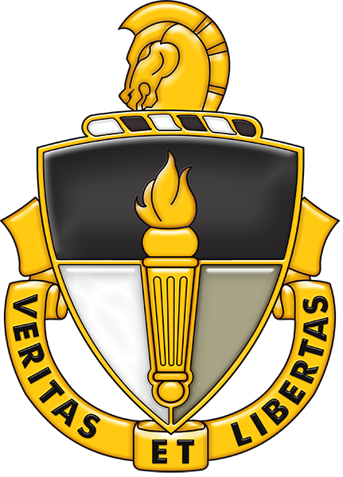
Questions and Comments

