Slide 1

U.S. European Command J9 – Interagency Partnering Directorate
3D Approach to
Resiliency
11/30/2023

Slide 2
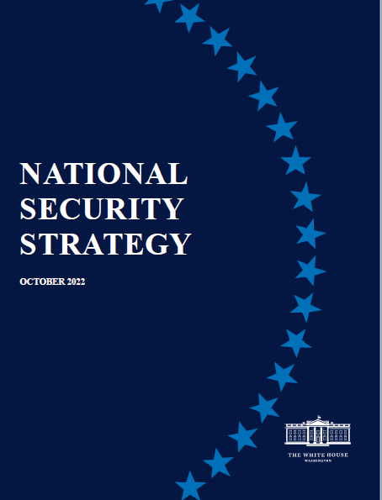
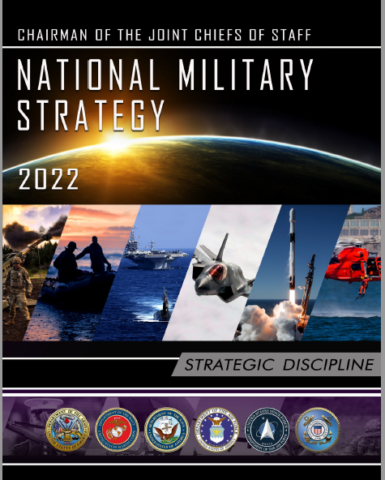
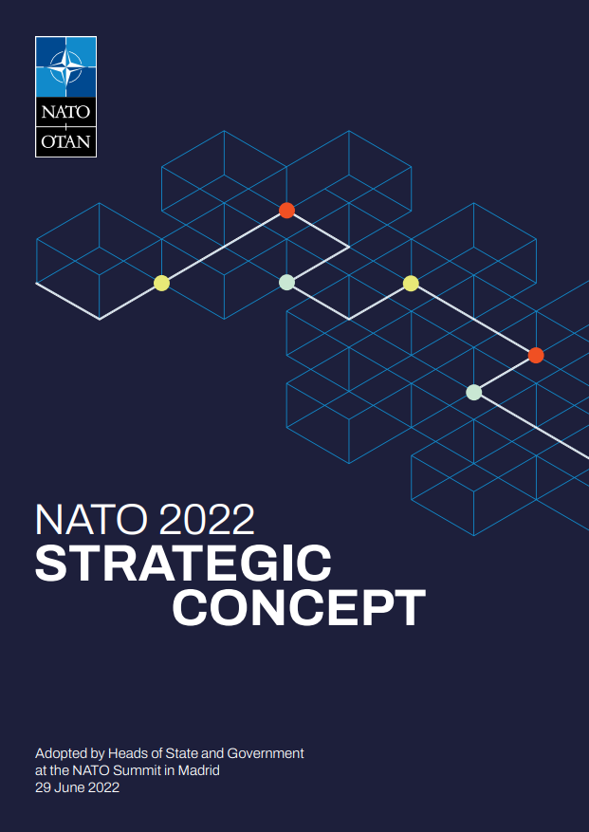

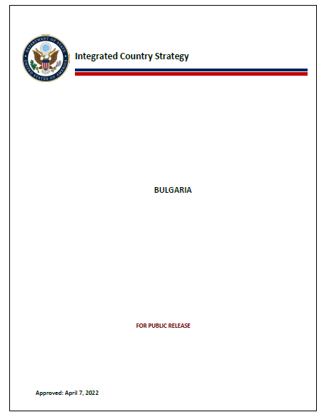
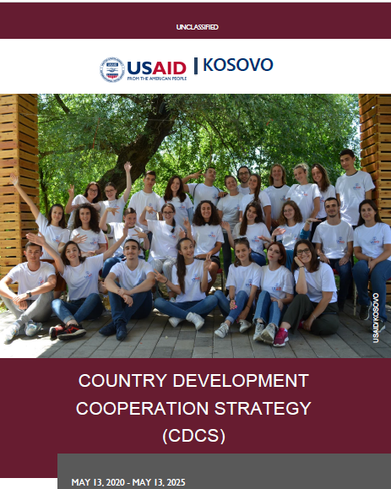


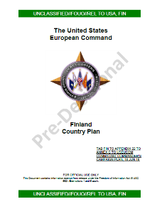
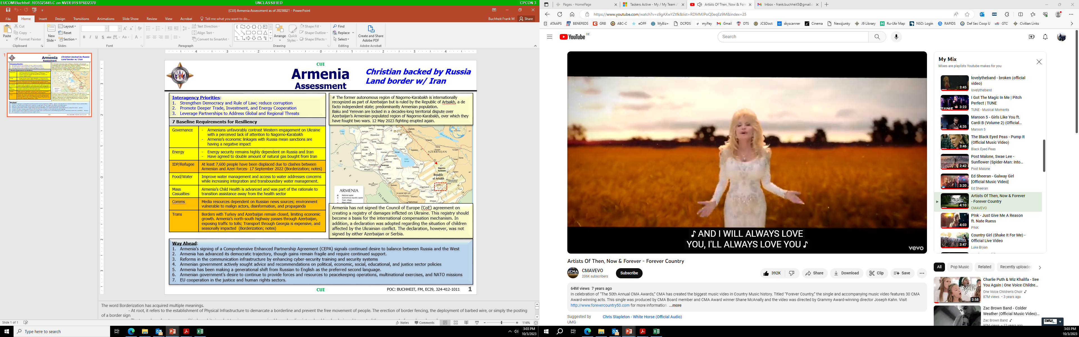
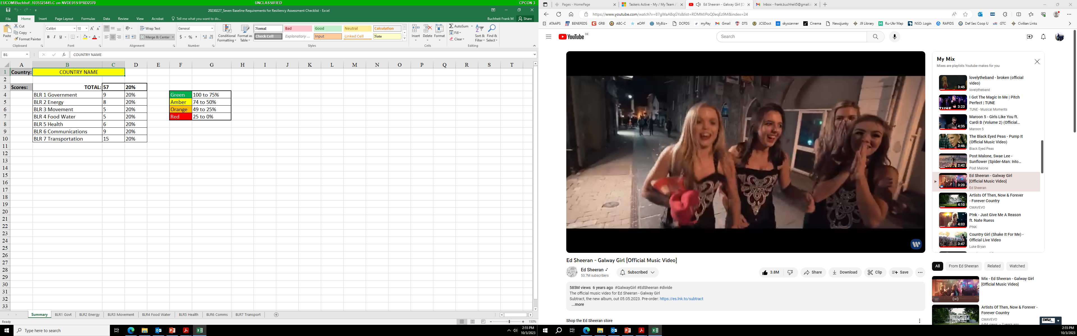



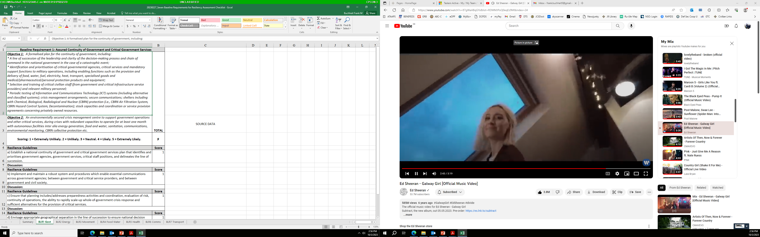




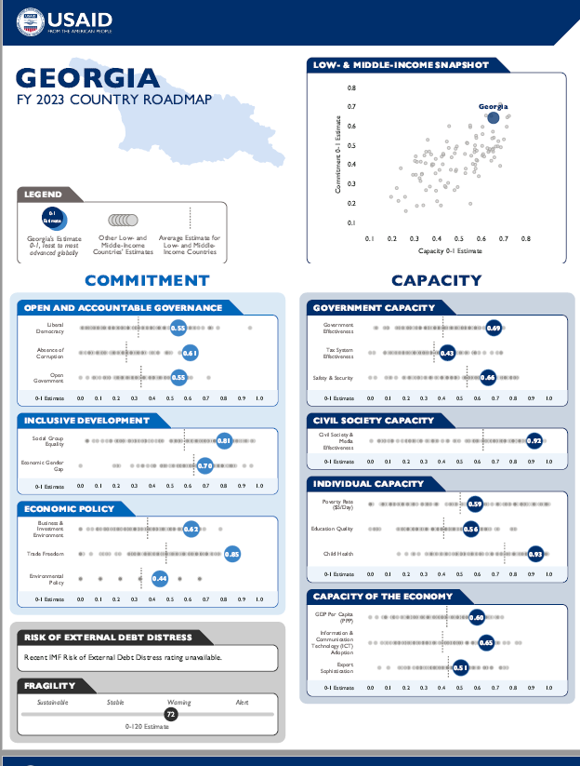
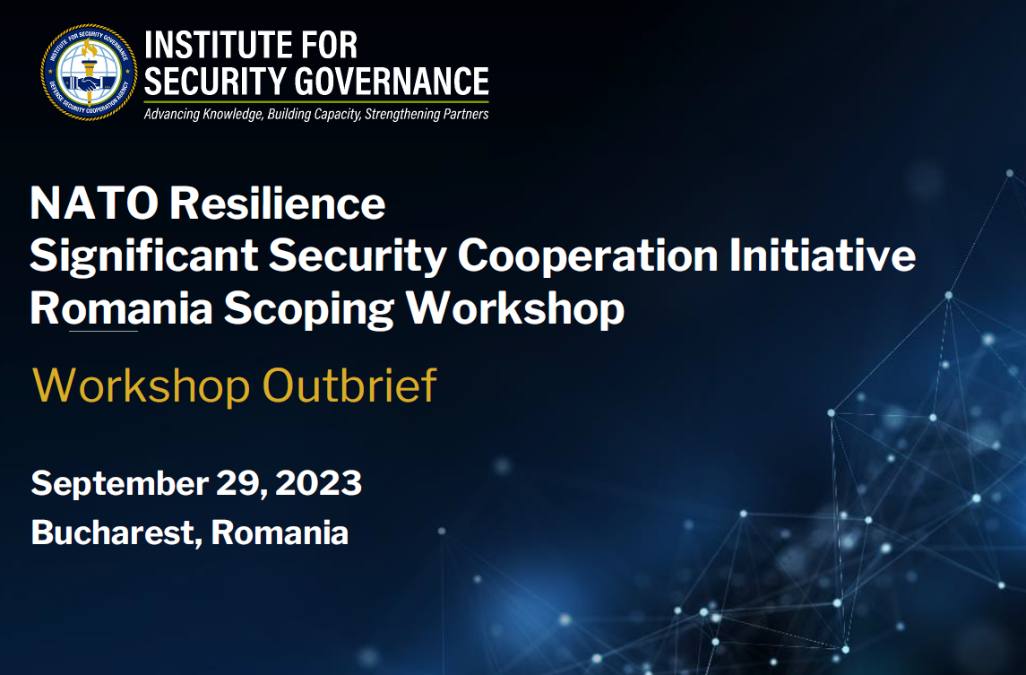
CUI
Resilience Executive Summary
Plan
Interagency
Synch Forum
EUCOM Strategy
Implementation
Conference (ESIC)
ICS
3D U.S.
Assessment
CDCS
Assess
Prepare
National/NATO
Assessment
Country Plans
Execute
Interagency
Working Group
Interagency
Activities
Convergence/
Interoperability
C2IE
Significant Security
Cooperation
Initiative (SSCI)
332, 333 Authorities
CUI
11/30/2023

Slide 3
UNCLASSIFIED
Background
1949 The North Atlantic Treaty: Article 3
  In order more effectively to achieve the objectives of this Treaty, the Parties, separately and jointly, by means of continuous and effective self-help and mutual aid, will maintain and develop their individual and collective capacity to resist armed attack.
2017 National Security Strategy
  The United States officially recognized resiliency in 2017, stating, that we must enhance our resilience—which includes the ability to withstand and recover rapidly from deliberate attacks, accidents, natural disasters, as well as unconventional stresses, shocks and threats to our economy and democratic system.
2019 Global Fragility Act
  Although the primary purpose of the GFA is to enhance stability and conflict prevention efforts, inherent in the goals of the law is the need to improve interagency coordination and cooperation across the U.S. government, particularly between the U.S. Department of State (DOS), the U.S. Department of Defense (DOD), and the U.S. Agency for International Development (USAID).
2020 U.S. Strategy to Prevent Conflict and Promote Stability (SPCPS)
  Building a long-term commitment to development in prioritized countries
  Increasing interagency cooperation across the U.S. government
2022 National Security Strategy
  Integration across the U.S. Government to leverage the full array of American advantages, from diplomacy, intelligence, and economic tools to security assistance and force posture decisions.
  Integration with allies and partners through investments in interoperability and joint capability development, cooperative posture planning, and coordinated diplomatic and economic approaches
2022 National Military Strategy
  Next Slide
11/30/2023
UNCLASSIFIED

Slide 4
UNCLASSIFIED
2022 National Military Strategy
Central Military
Problem
Central Idea
Ways
Joint Task Force
Strategic
Objectives
Risk
Strengthen Homeland Defense
Enhance Deterrence
Prepare to Win
Integrate Joint and Combined Efforts
Leverage Opportunities in Campaigning
Reinforce Diplomacy
Strengthen Relationships with Allies and Partners
Prioritize Concepts and Resources
Build a Resilient Joint Force
Integrate Capabilities Rapidly
Defend the Homeland
Know the enemy
How does the Joint Force rapidly develop future warfighting advantage while deterring today?
Campaigning
Deter
Attack
Strategic
Discipline
Building
Warfighter
Advantage
Prevail in
Conflict
Understand
Future Fight
Modernize
the Force
Theory of
Success
Assessments
Lethal Survivable Sustainable Resilient Agile and Responsive Globally Integrated
11/30/2023
UNCLASSIFIED

Slide 5
CUI
EUCOM Planning Hierarchy
Commanders Campaign Plan
CCP Annex C
Operations
CCP Appendix 22
Theater Security Cooperation
ECJ5/8 Plans
ECJ3
Tabs A-Z
Country Plans
ECJ5 Regionals
ECJ5 Regionals
Country Plans and Significant Security Cooperation Initiatives (SSCI) Process Management (OPR: ECJ5)
Essential Services & Resilience Line of Activity (OPR: ECJ9): SSCI Execution Management
  333 Implementation (EJC9: JICTC) Authority to build capacity, Foreign security forces
  332 Implementation (ISG) Defense Institution Building (DIB) of friendly foreign countries
CUI
11/30/2023

Slide 6

UNCLASSIFIED
NATO Resilience Model
Resilience
Individual and collective capacity to for Allies to resist and recover from military, civilian, economic or commercial shocks, absorb damage and resume function as quickly and efficiently as possible
Civil Preparedness is an Allied Nation responsibility
Three (3) core elements:
Continuity of government
Continuity of essential services to the population
Continuity of civil support to military operations
7 Baseline Resilience Requirement (7BLRs)
Continuity of Government
Resilient Energy Supply
Resilient Food and Water Supply
Resilient Communication Systems
Resilient Transportation Systems
Ability to deal with Uncontrolled Movement of People
Ability to deal with Mass Casualties
11/30/2023
UNCLASSIFIED

Slide 7
UNCLASSIFIED
EUCOM J9 Resilience Initiative
The ECJ9 has four (4) primary efforts to support resilience for countries in our AOR.
NATO Resilience SSCI (in support of Country Plans), is scoping and assessing resilience with partners in North Macedonia, Romania, and Bulgaria, and conducting training to help build resilience.
Resilience Assessments and gap analyses, of Allies and Partners using 3D approach. These assessments highlight gaps in resilience which the team will look to use diplomatic, development, and defense resources to address.
Women, Peace and Security (WPS)
Civilian Harm Mitigation and Response (CHMR)
State Partnership Program (SPP)
Goal: ECJ9 integrates the capabilities of the whole of the U.S. government to build resilience in priority countries
11/30/2023
UNCLASSIFIED

Slide 8
UNCLASSIFIED
EUCOM 3D Approach
Diplomacy, Development, and Defense (3Ds) – as represented by the Department of State (State), the United States Agency for International Development (USAID), and the Department of Defense (DoD or Defense) – are the three pillars that provide the foundation for promoting and protecting U.S. national security interests abroad
Coordination begins with Planning:
  DOS: Integrated Country Strategy (ICS)
  USAID: Country Development Cooperation Strategies (CDCS)
  DOD: Country Plans, Lines of Activity(LOAs) and SSCIs
11/30/2023
UNCLASSIFIED

Slide 9
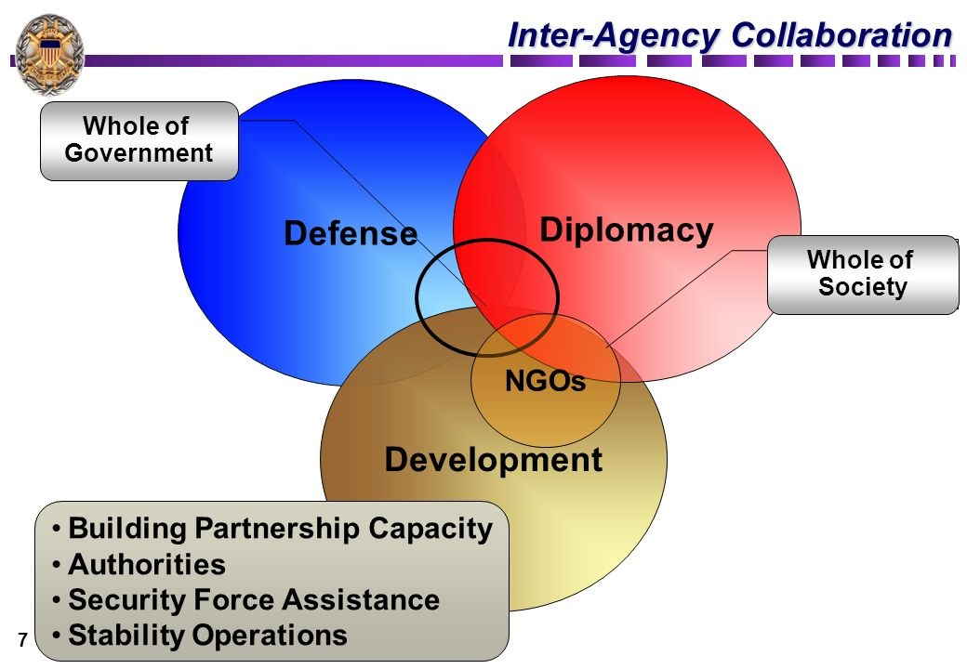
UNCLASSIFIED
EUCOM J9 3D Assessment
This is not a grading scale or a push to NATO standards
Objective is to establish a common resiliency lexicon and metrics
Tool for the Mission/Interagency to use for strategic planning and assistance to the country
The NATO BLR Framework is used for each country to develop a common assessment of risk to forces and mission
Seek adjustments or new opportunities and priorities to address gaps through Integrated Deterrence
Develop, synchronize and communicate activities and opportunities to enhance resiliency
Track Interagency Activities on C2IE to provide the command an understanding of all IA operations, activities and investments currently being conducted in support of a given nation.
Crosswalk activities with identified gaps and identify potential opportunities. Link those activities to campaign plan objectives
Overall, the goal is to apply a strategy of Integrated Deterrence to enhance national resiliency.
11/30/2023
UNCLASSIFIED

Slide 10
CUI
EUCOM J9 3D Assessment
3
The color assessment is then used on the summary PowerPoint along with headline topics, Interagency priorities from the ICS, a map depicting a friction point and Opportunities in blue at the bottom
2
These quantitative assessments are rolled up on the summary slide and color coded; Red, Orange, Amber and Green; from least to most resilient
1
Each of the seven (7) Baseline Requirements has between 6 and 15 metrics which provide a quantitative assessment
CUI
11/30/2023

Slide 11
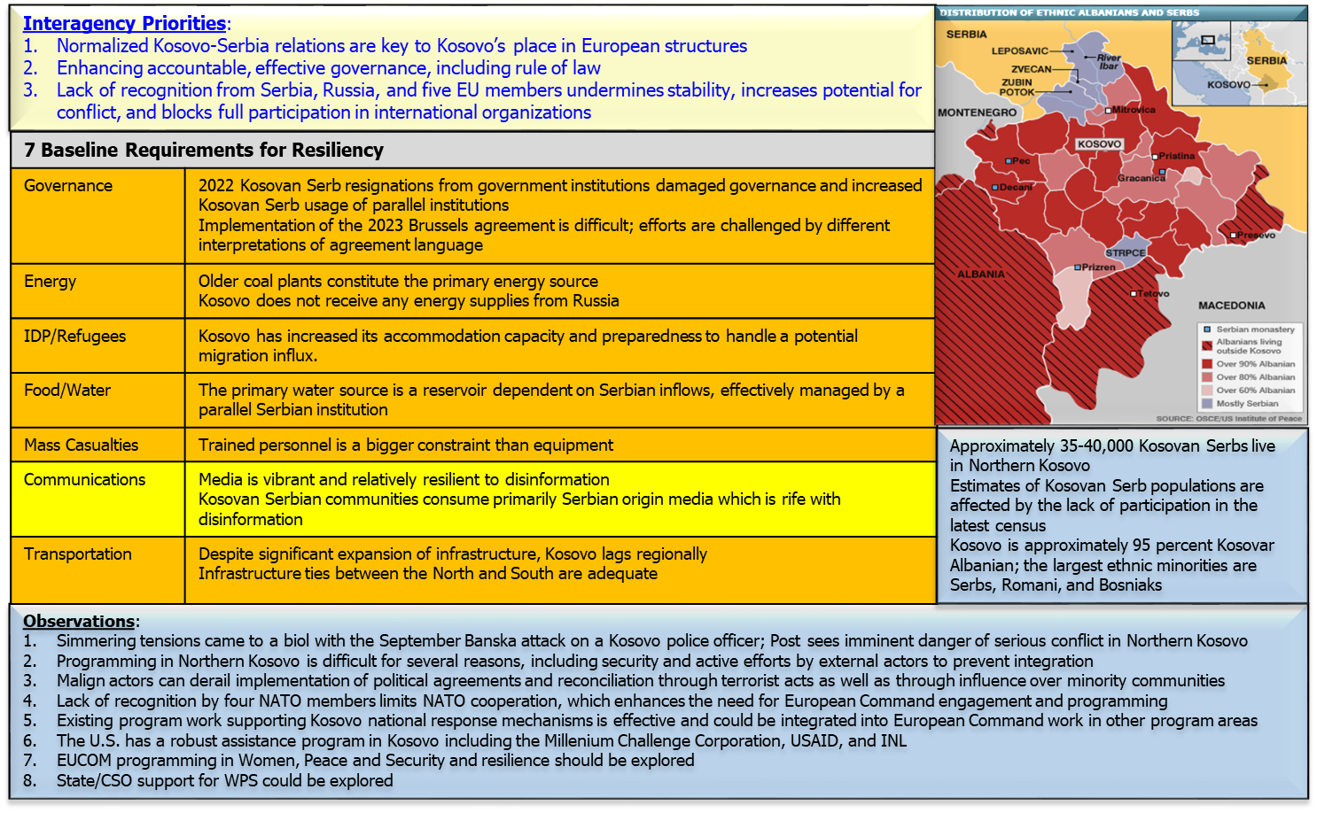
CUI
Example: Kosovo Assessment
CUI
11/30/2023

