Slide 1


Peace Operations in the AFRICOM AOR:
A Complex Systems Modeling Approach
13 DEC 2023
US Army Heritage and Education Center (USAHEC)
Carlisle, PA
Dr. Katy Lindquist
klindquist@nsiteam.com
Dr. Lawrence A. Kuznar
lkuznar@nsiteam.com
12/11/23

Slide 2
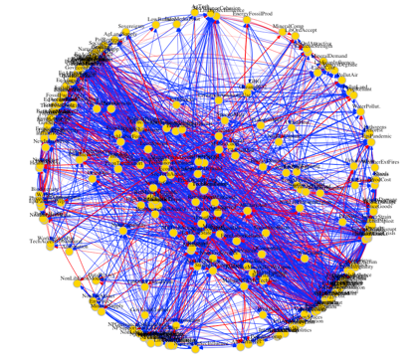

Predicting Instability
History of NSI Operational Environment (OE) Project
Phase 1: Empirical Exploration of the 24 Conditions
Development of the AFOE model of exploitable conditions
Tasker to SMA (Strategic Multilayer Assessment) Office: Joint Staff J7 Memo, Anticipating the Future Operational Environment (AFOE) – Modeling Exploitable Conditions
“Extend previous work by TRADOC G-2 on Competition in 2035 to:
Assess the “relationships among scientific, technical, political, economic, social, human development, and other conditions”
Consider “direct and indirect relationships in political, biological, economic, anthropological, and technical environments”
Global Exploitable Conditions Model (GECM):
248 “nodes” (factors/variables)
1,500+ edges (relationships)
17 sub-systems supported by 1000+ source citations
Phase 2: AFRICOM Exploitable Conditions Model (AECM)
Tailored model for the 53-country* USAFRICOM AOR
Comprised of 996 edges between 165 nodes.
Draws on desk-based research on key model nodes from all 17 GECM sub-systems & consultation with SMEs
2,500+ source citations
In the context of competition, identify exploitable conditions in the future global operational environment.
Phase 3: Climate Impacts on Political, Social, and Economic Dynamics in W. Africa
Point of Contact: Dr. Lawrence A. Kuznar, lkuznar@nsiteam.com
12/11/23

Slide 3

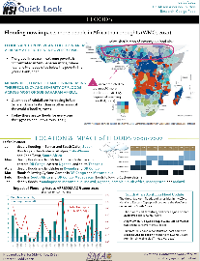
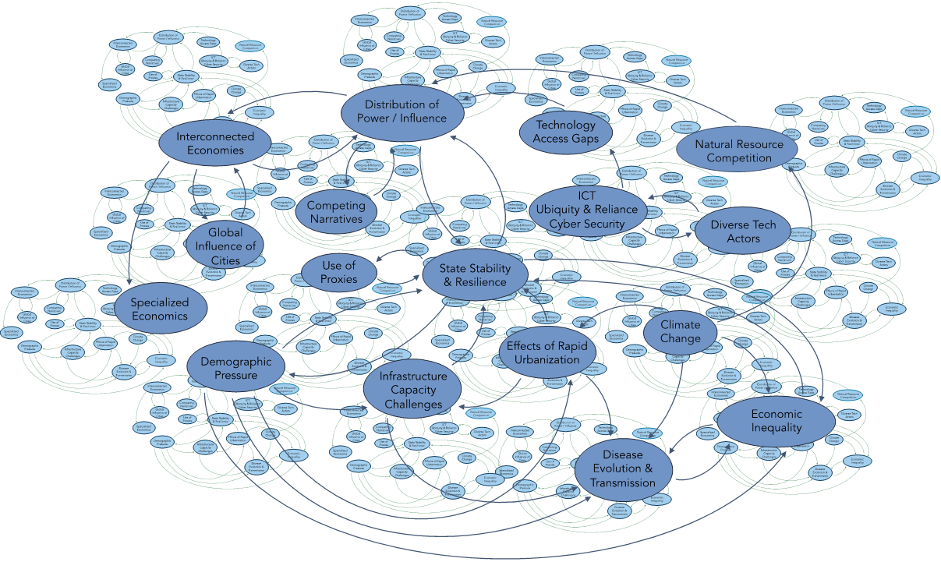
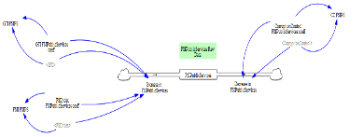
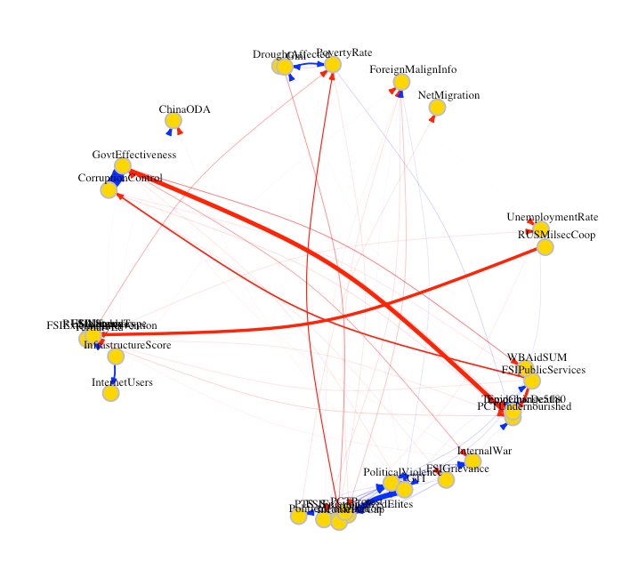
Predicting Instability
AFOE Conceptual and Computational Modeling
Generic GECM
Global Exploitable Conditions Model
System-of-Systems Model with
1,567 edges, 248 nodes
AECM
Africom Exploitable Conditions Model
Node definitions and edges specified to 53-country AFRICOM AOR. Comprised of 996
edges between 165 nodes.
AECM
Quick Looks
Tailored to
GECM Network, System-of-Systems
GECM Network Analysis
AECM Network Analysis
Reduced to
AECM Sahel System
Dynamics Model
System dynamics model in Vensim, 23 nodes and 80 edges, representing the 26 countries of the Sahel area.
AECM Sahel
Network Model
AECM down-selected to 38 nodes and 190 edges, with data covering 26 countries of the Sahel area.
Computational modeling database
GECM Loop Diagram, System-of-Systems
Sahelian SD Model
Point of Contact: Dr. Lawrence A. Kuznar, lkuznar@nsiteam.com
12/11/23

Slide 4
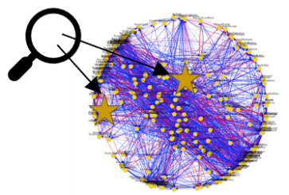
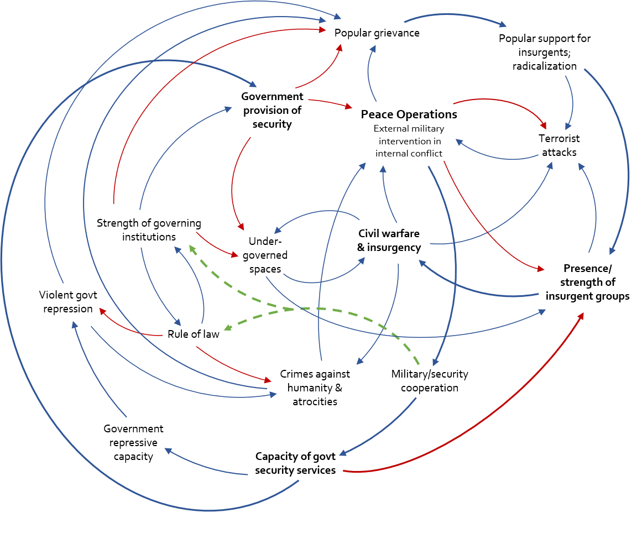
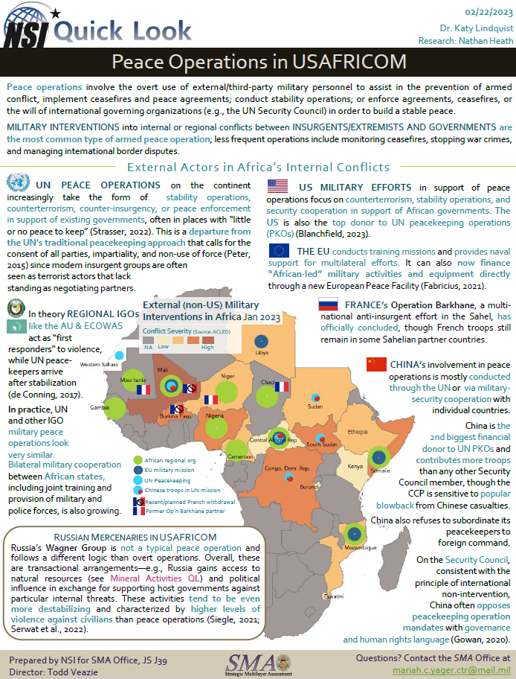
Predicting Instability
Peace Operations in the GECM
Peace Operations
Report
Peace Operations:
Model Subsystem Loop
Red = negative impact
Blue = positive impact
Dotted green = potential impact
Point of Contact: Dr. Lawrence A. Kuznar, lkuznar@nsiteam.com
12/11/23

Slide 5
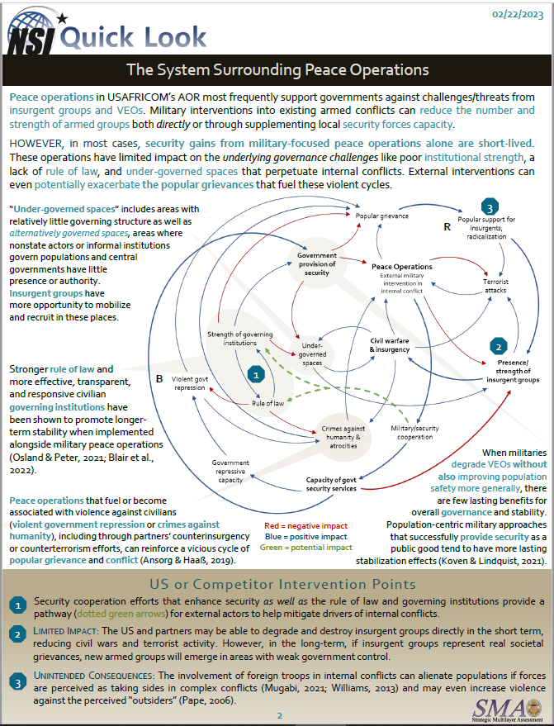
Predicting Instability
Harder-to-measure desirable outcome
Popular grievance
Measurement & Collection
in Complex Environments
A ‘complete picture’ for assessment requires a lot of information when the system is complex and dynamic
Some key factors may be harder to measure than others
Easier-to-measure factors may be in a very different part of the system
Identifying What Matters
Popular support for insurgents; radicalization
Government provision of security
Theories of Change in a Complex System
Models can help think through theories of change (including “levers and pulleys”) needed to identify where planned and implemented activities should impact the system
It can also identify factors that might enhance the desired effect on the system – and mitigate unintended, unwanted consequences:
Improving “rule of law”
Bolstering “strength of governing institutions”
Peace Operations
External military
intervention in
internal conflict
Terrorist
attacks
Strength of governing institutions
Under-governed
spaces
Civil warfare
& insurgency
Presence/
strength of insurgent groups
Easier-to-measure desirable outcome
Violent govt
repression
Rule of law
Crimes against humanity & atrocities
Military/security
cooperation
Operations, activities, and investments
Government repressive capacity
Capacity of govt security services
Node SC seeks to influence
Red = negative impact
Blue = positive impact
Dotted green = potential impact
5
4
Peace Operations Quick Look
Point of Contact: Dr. Lawrence A. Kuznar, lkuznar@nsiteam.com
12/11/23

Slide 6
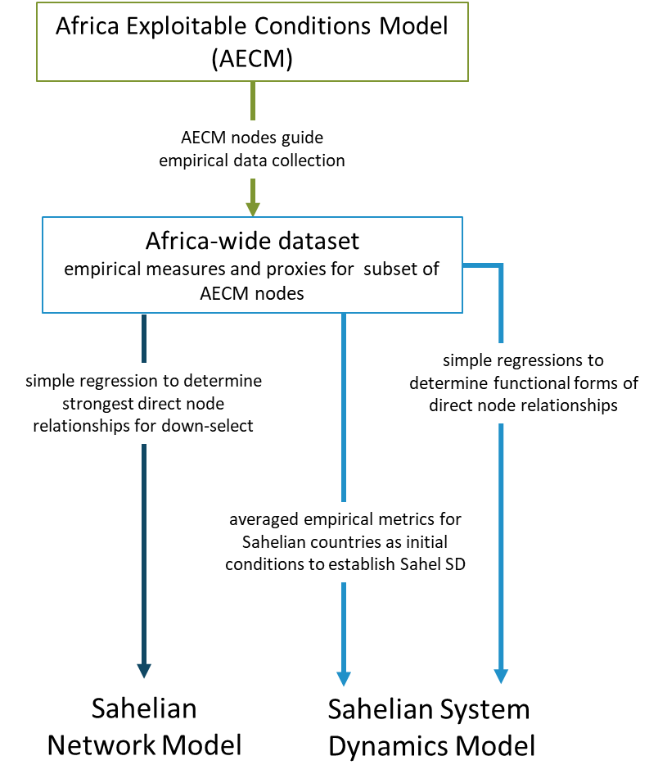
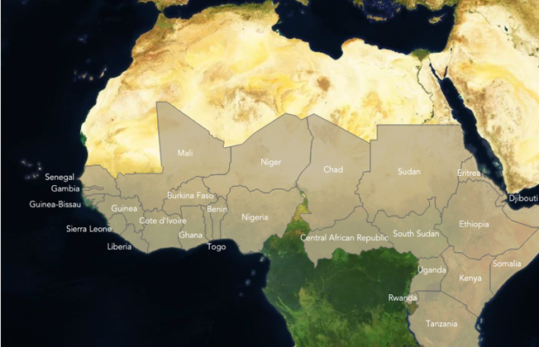
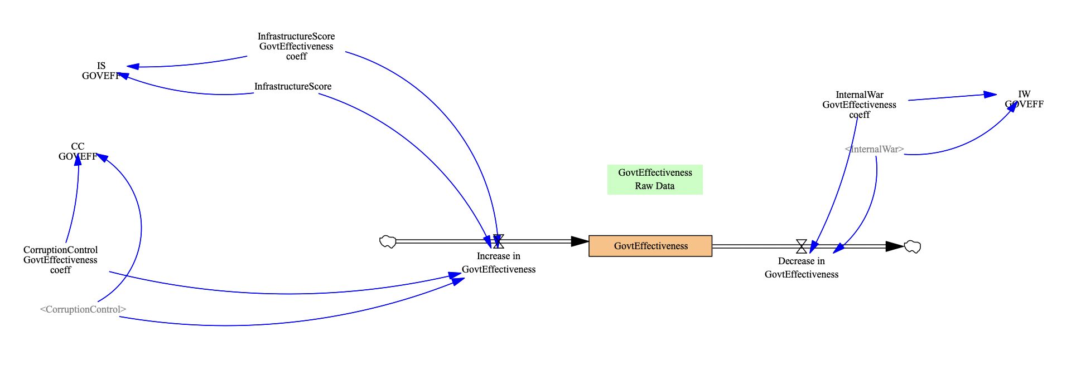
Predicting Instability
Sahel Computational Models
Focused model on key nodes in the Sahel
  Network Analysis
  System dynamics modeling
Point of Contact: Dr. Lawrence A. Kuznar, lkuznar@nsiteam.com
12/11/23

Slide 7
Predicting Instability
Sahel Network Model:
Identifying Drivers
10 network centrality metrics used to gauge key nodes in the system
Key Drivers of Change in the African OE
  Terrorism
  Violent Conflict
  Governing capacity
  Polarization
  Corruption
Point of Contact: Dr. Lawrence A. Kuznar, lkuznar@nsiteam.com
12/11/23

Slide 8
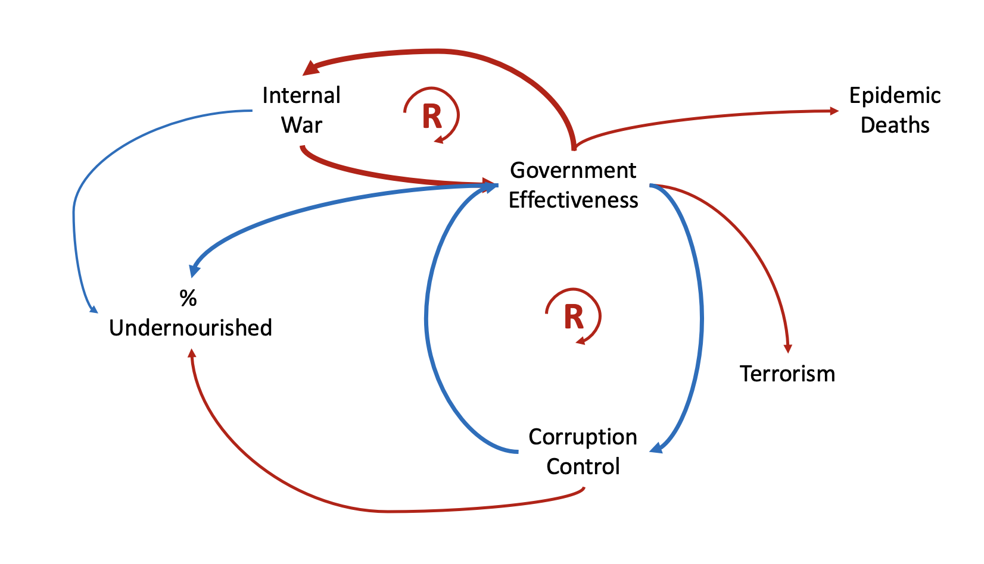

Predicting Instability
The Government Effectiveness/Internal War/Corruption Network
These conjoined loops are an engine that can accelerate change
Network Analysis
Edges proportionate to standardized coefficients
Conjoined reinforcing loops
  Internal war, when it occurs, has a very strong effect on government effectiveness AND is in a reinforcing loop
  e.g. Sierra Leone, Liberia, CAR, Somalia, etc.
  Government effectiveness & corruption control also have strong effects AND are in a reinforcing loop
Operational Implication:
If one is worried about epidemic crisis, terrorism, malnourishment, you need to do something about the conjoined loops
Red – negative influence
Blue – positive influence
- reinforcing loop
Providing food is not enough
The conjoined loops are linked to just about all USAFRICOM concerns
Point of Contact: Dr. Lawrence A. Kuznar, lkuznar@nsiteam.com
12/11/23

Slide 9
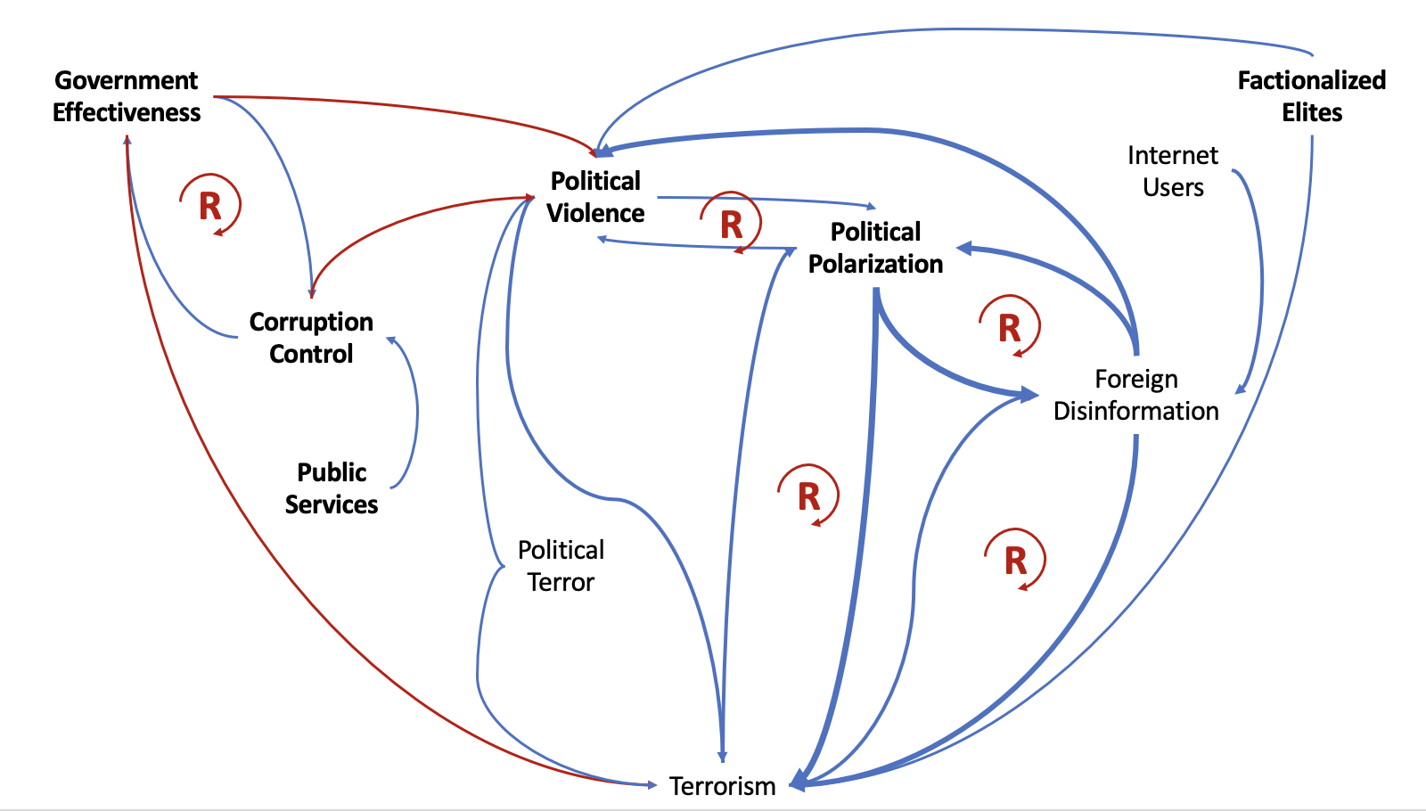
Predicting Instability
The Terrorism Nexus
System dynamics model
Edges (flows) are proportionate to change in model
(Internal war not shown but present)
(SD model a little different from the network model in structure)
Terrorism and its 2nd order relationships
Note the reinforcing loops!
Foreign disinformation and political polarization change dramatically in the model → they have great potential to drive the system
The govt – corruption – war nexus
Online media can drive polarization
Loops = exponential change
Red – negative influence
Blue – positive influence
- reinforcing loop
Point of Contact: Dr. Lawrence A. Kuznar, lkuznar@nsiteam.com
12/11/23

Slide 10
Predicting Instability
Conclusions
Peace operations act on a complex system, especially in Africa
Complex system models shed light on:
  Drivers of violence and instability (as well as peace and stability!)
  Effects of peace operations
Loop diagrams provide insights into:
  What nodes need to be targeted in a peace operation
  Reinforcing relationships that may be particularly difficult to break
Network models identify
  Drivers in the system and most affected nodes
  Provide metrics of potential influence, can aid targeting what to influence in a system
System dynamics models
  Provide further metrics and track flow of influence throughout the system
  Can aid in predicting amount of effect a peace operation may have
Point of Contact: Dr. Lawrence A. Kuznar, lkuznar@nsiteam.com
12/11/23

Slide 11
Predicting Instability
Questions?
Point of Contact: Dr. Lawrence A. Kuznar, lkuznar@nsiteam.com
12/11/23

